Slide 1
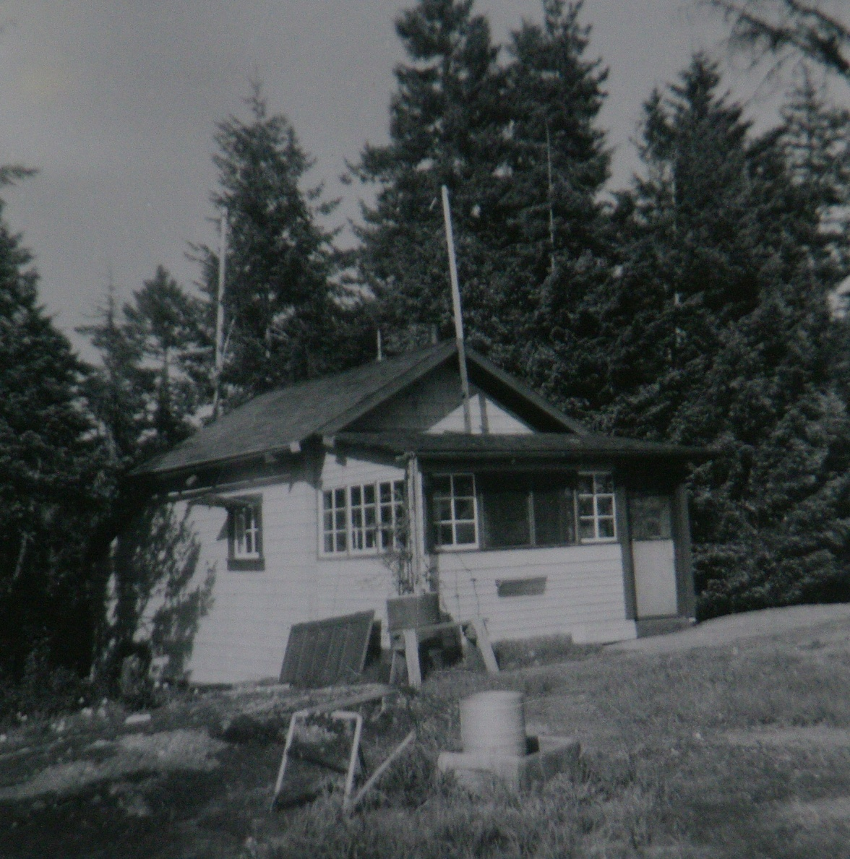
Coastal Fire Centre
Duncan Fire Suppression Camp
circa 1950:
Camp Cookhouse
courtesy
Bruce Granholm

Slide 2
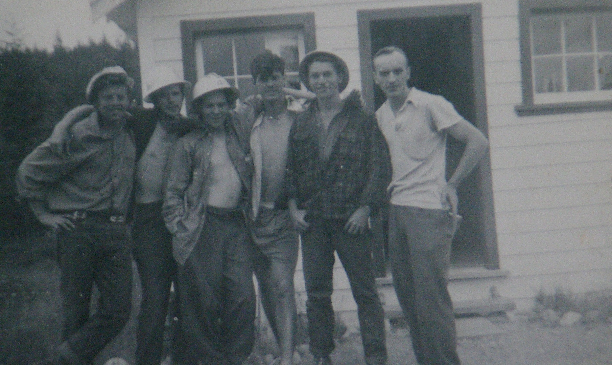
Coastal Fire Centre
Duncan Fire Suppression Camp circa 1950 Partial Crew:
David Smith (2nd from left);
Bruce MacDonald (2nd from right)
courtesy Bruce Granholm

Slide 3
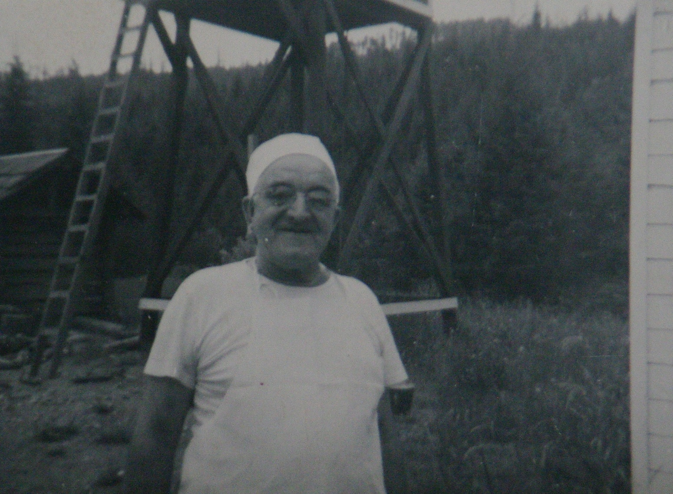
Coastal Fire Centre
Duncan Fire Suppression Camp
circa 1950:
Camp Cook
courtesy
Bruce Granholm

Slide 4
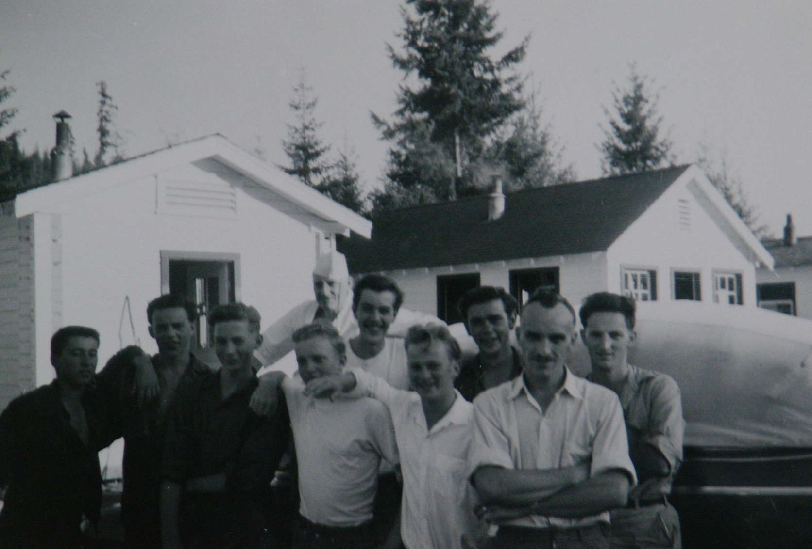
Coastal Fire Centre
Duncan Fire Suppression Camp circa 1950: Part of Crew, Cook and Foreman
Bob Norcross (2nd from left): Walter Wickman (3rd from left); Bruce Granholm (3rd from left)
courtesy Bruce Granholm

Slide 5
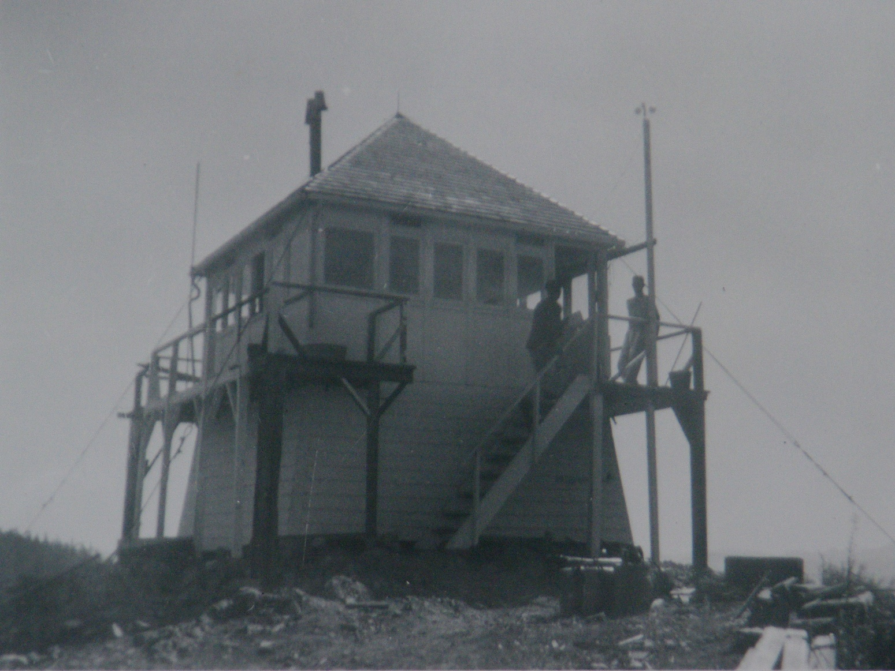
Coastal Fire Centre
Duncan Fire Suppression Camp circa 1950: Hill 60 Fire Lookout Tower
courtesy Bruce Granholm

Slide 6
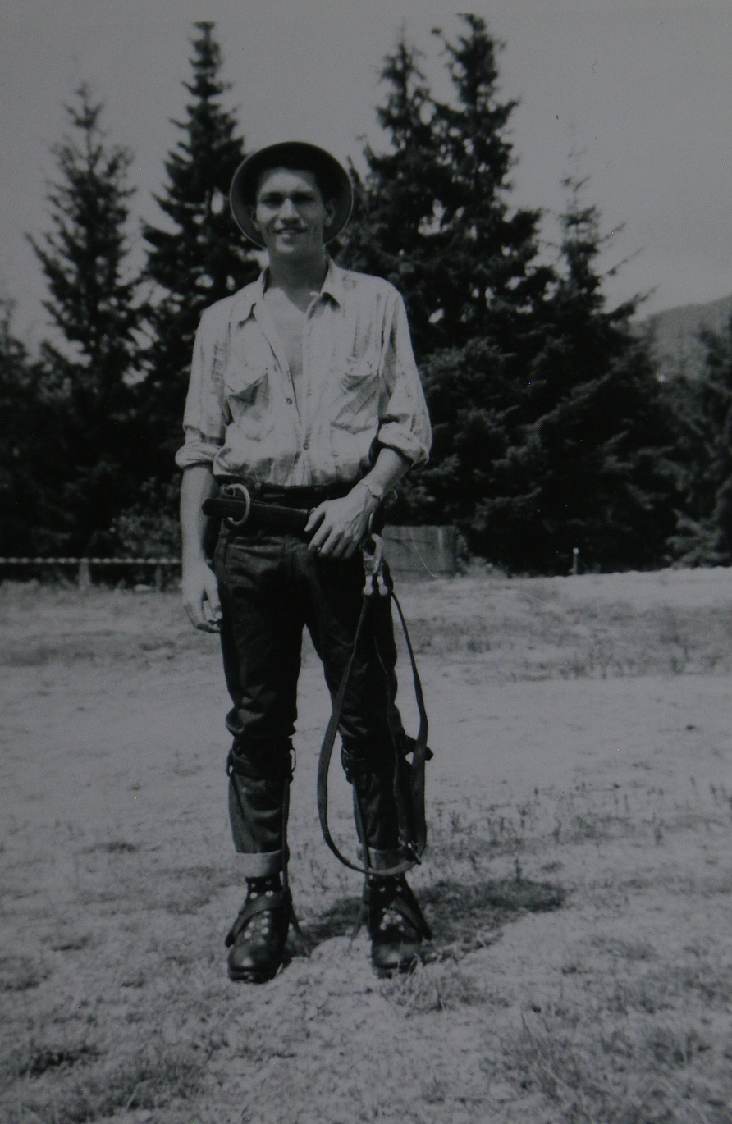
Duncan Fire Suppression Camp
circa 1950:
Crewman Bruce MacDonald with climbing spurs and belt.
courtesy
Bruce Granholm

Slide 7
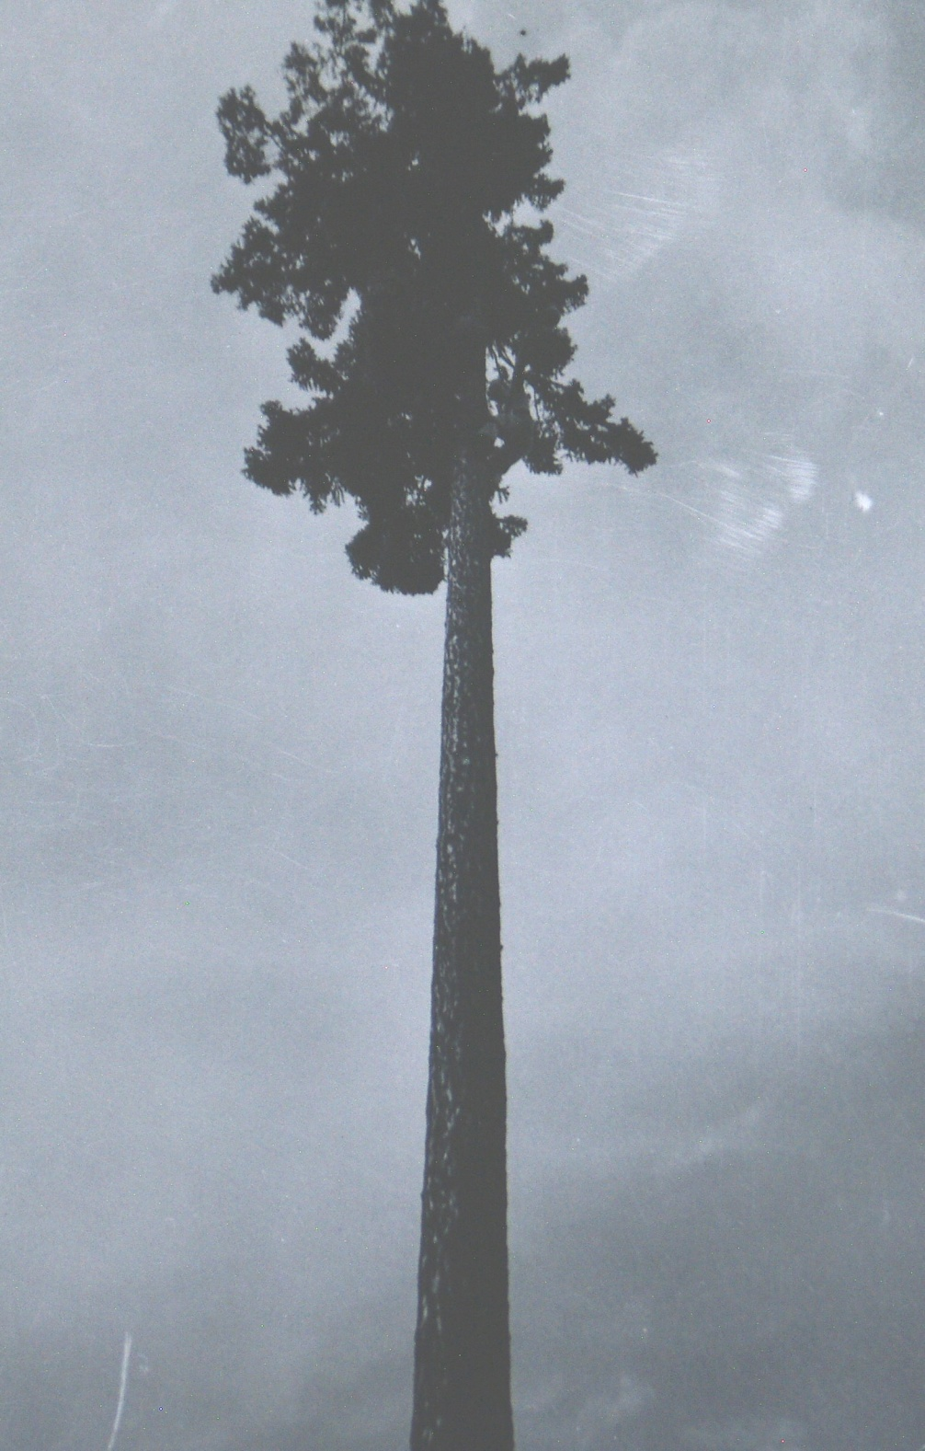
Duncan Fire Suppression Crew circa 1950
courtesy Bruce Granholm

Slide 8
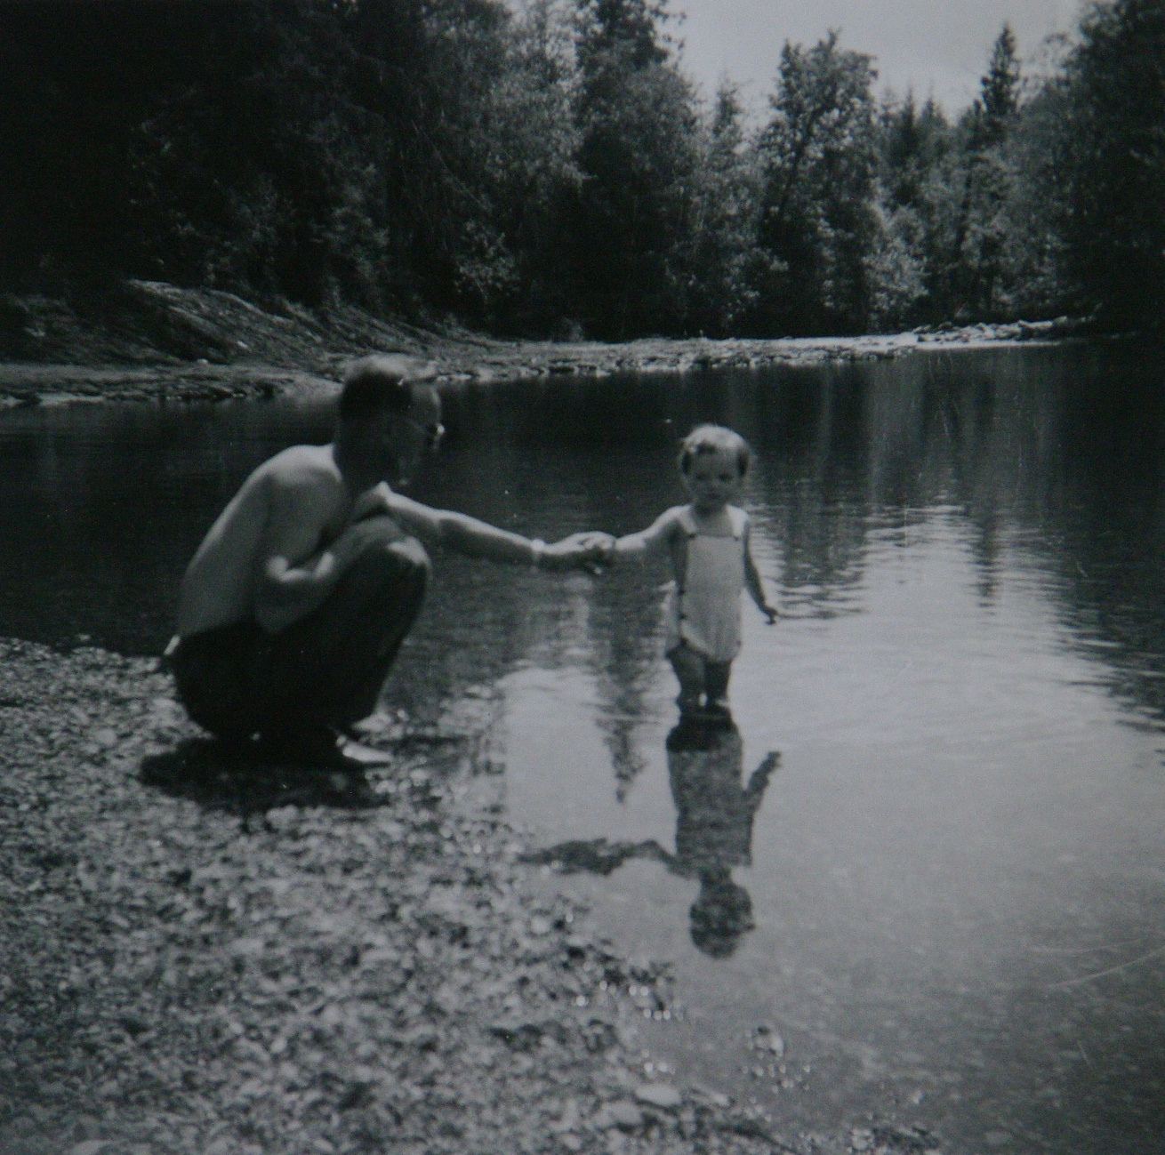
Coastal Fire Centre
Duncan Fire Suppression Camp
circa 1950:
foreman
Burt
Webster with his daughter
courtesy
Bruce Granholm

Slide 9
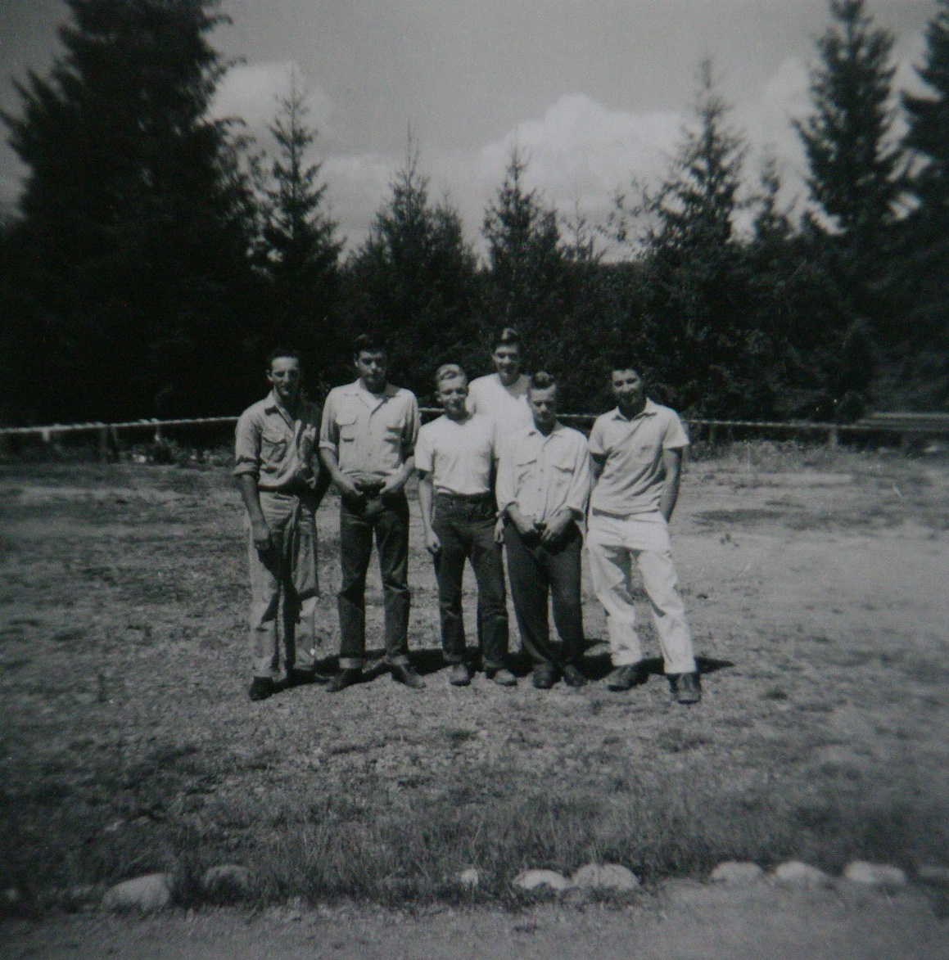
Coastal Fire Centre
Duncan Fire Suppression Crew circa 1950:
Standing before hose drying rack
courtesy
Bruce Granholm

Slide 10
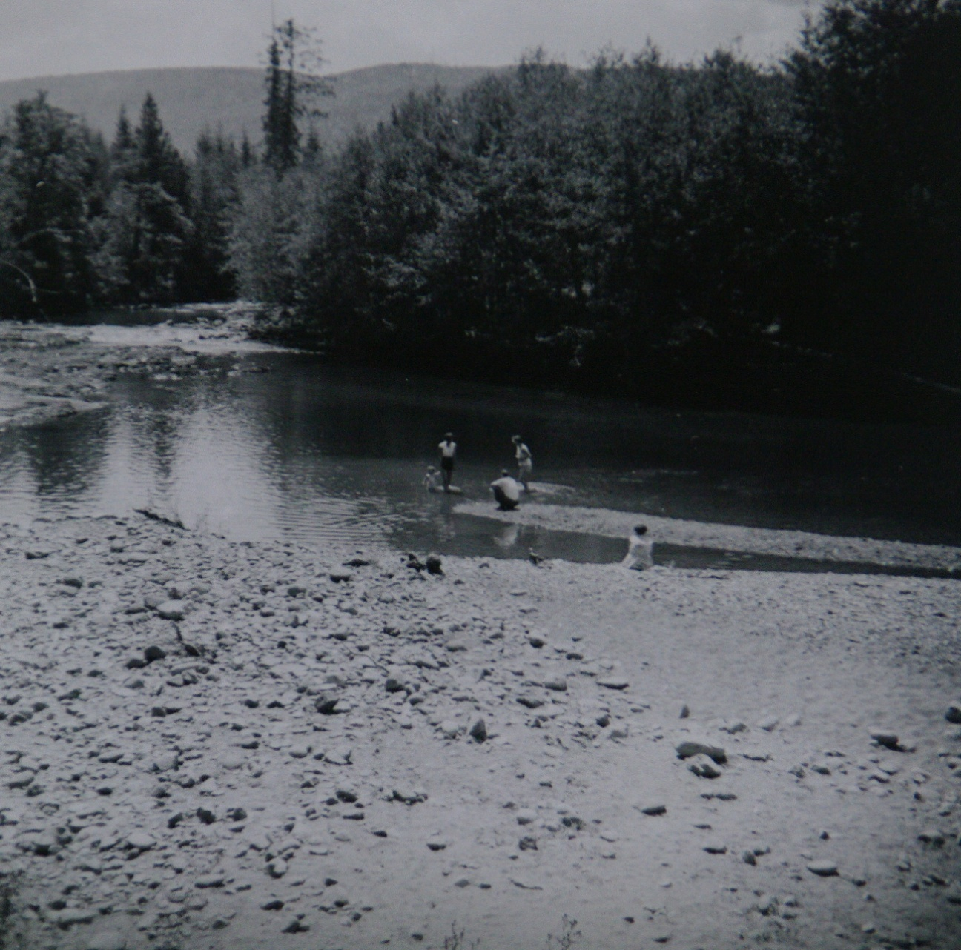
Coastal Fire Centre
Duncan Fire Suppression Camp
circa 1950:
favourite swimming hole in the Chemainus River
courtesy
Bruce Granholm

Slide 11
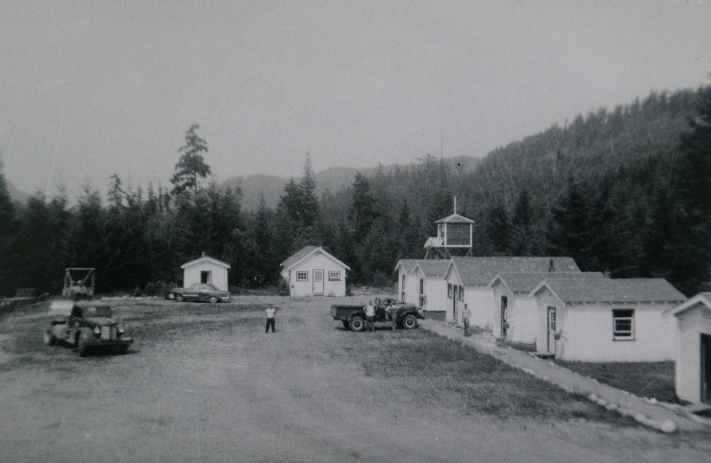
Coastal Fire Centre
Duncan Fire Suppression Camp circa 1950 courtesy Bruce Granholm

Slide 12
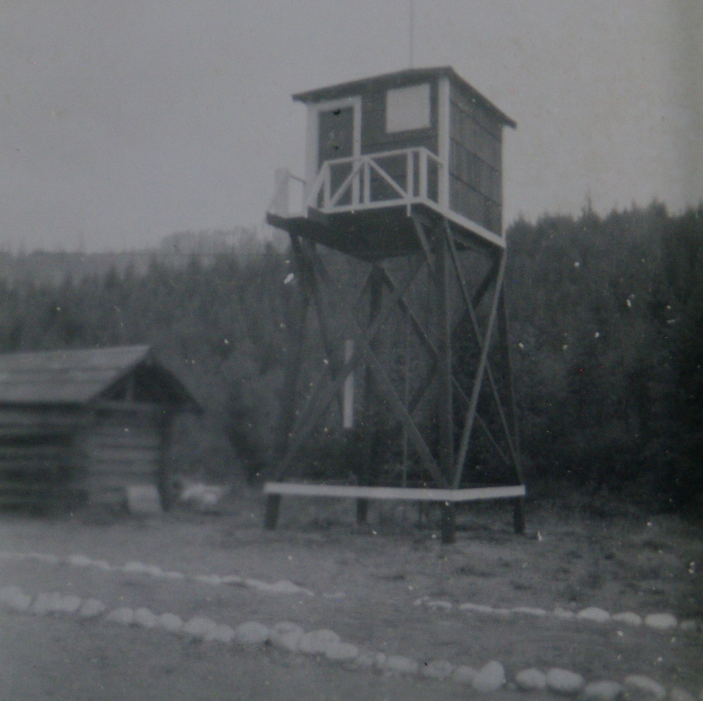
Coastal Fire Centre
Duncan Fire Suppression Camp
circa 1950:
Water Tower
courtesy
Bruce Granholm

Slide 13
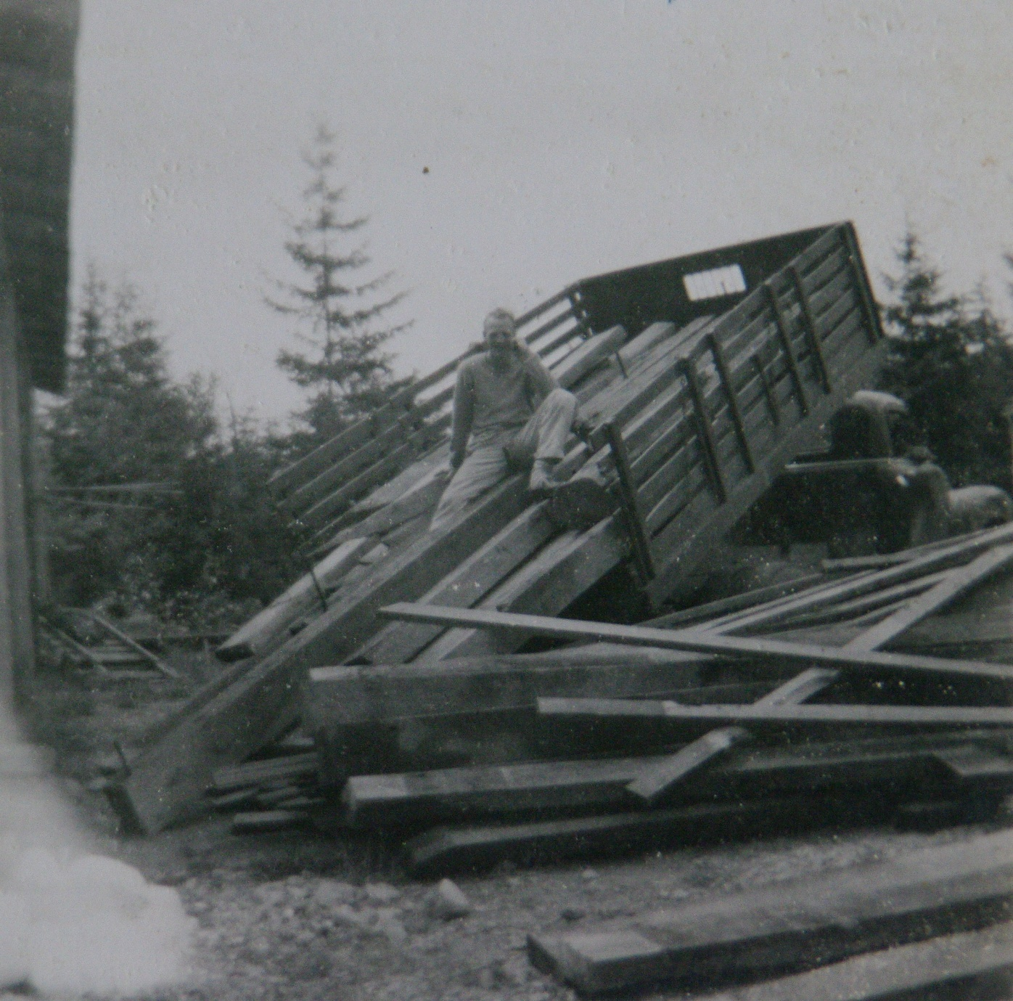
Duncan Fire Suppression Camp circa 1950:
Foreman
Burt Webster courtesy
Bruce Granholm

Slide 14
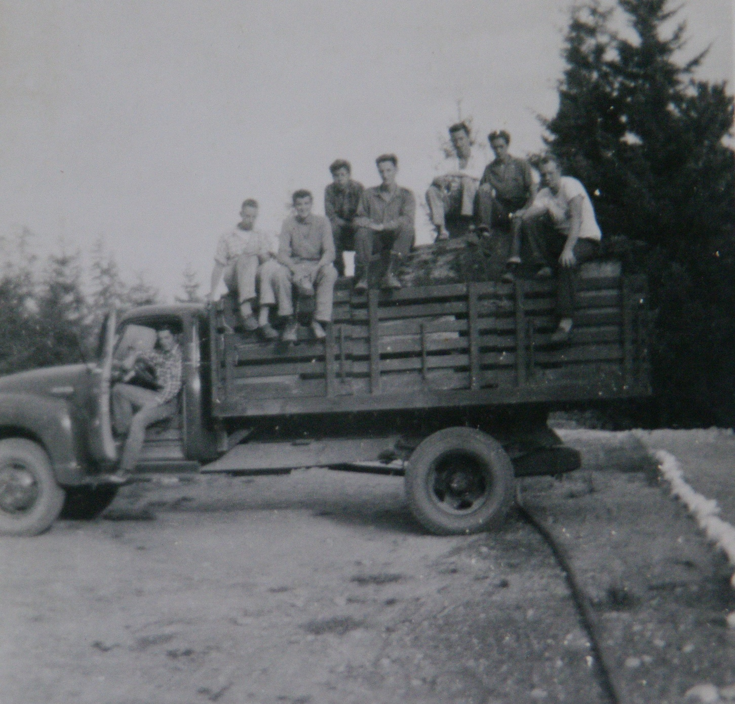
Coastal Fire Centre
Duncan Fire Suppression Camp
Circa 1950:
Shake Bolts for Langford
courtesy
Bruce Granholm

Slide 15
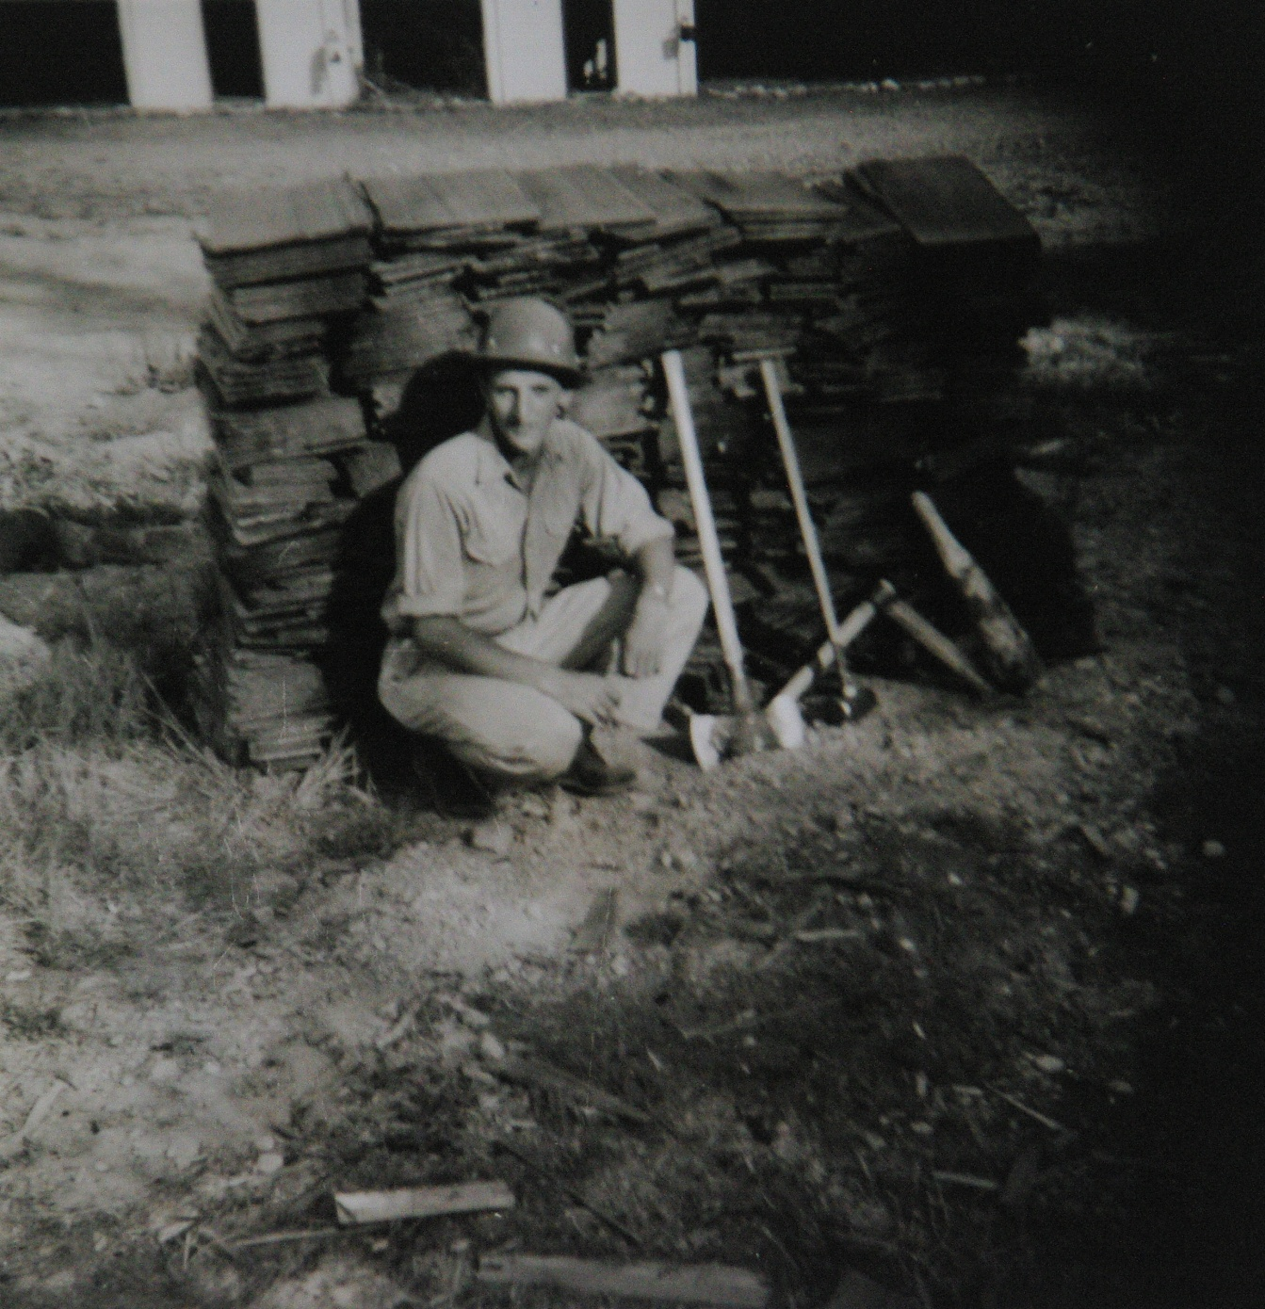
Coastal Fire Centre
Duncan Fire Suppression Camp
circa 1950:
Bruce
Granholm with Shakes
courtesy
Bruce Granholm

Slide 16
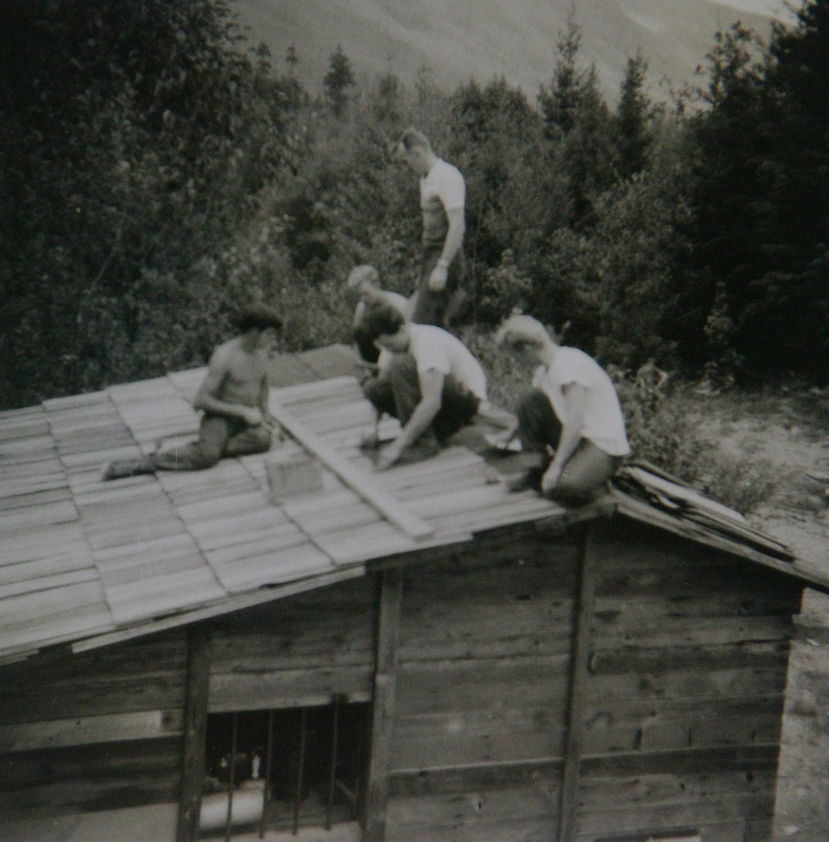
Coastal Fire Centre
Duncan Fire Suppression Camp
circa 1950
New Tool Shed Roof
courtesy
Bruce Granholm

Slide 17
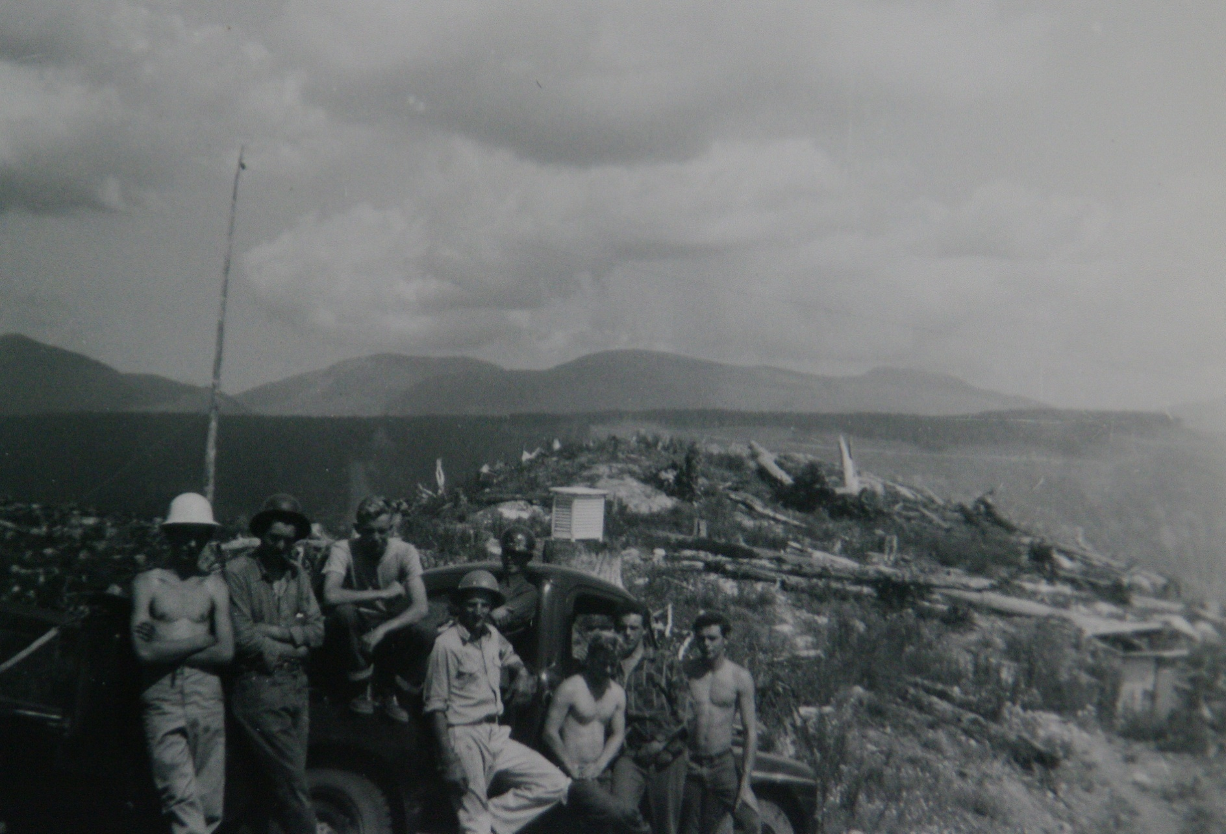
Coastal Fire Centre
Duncan Fire Suppression Crew circa 1950:
courtesy Bruce Granholm

Slide 18
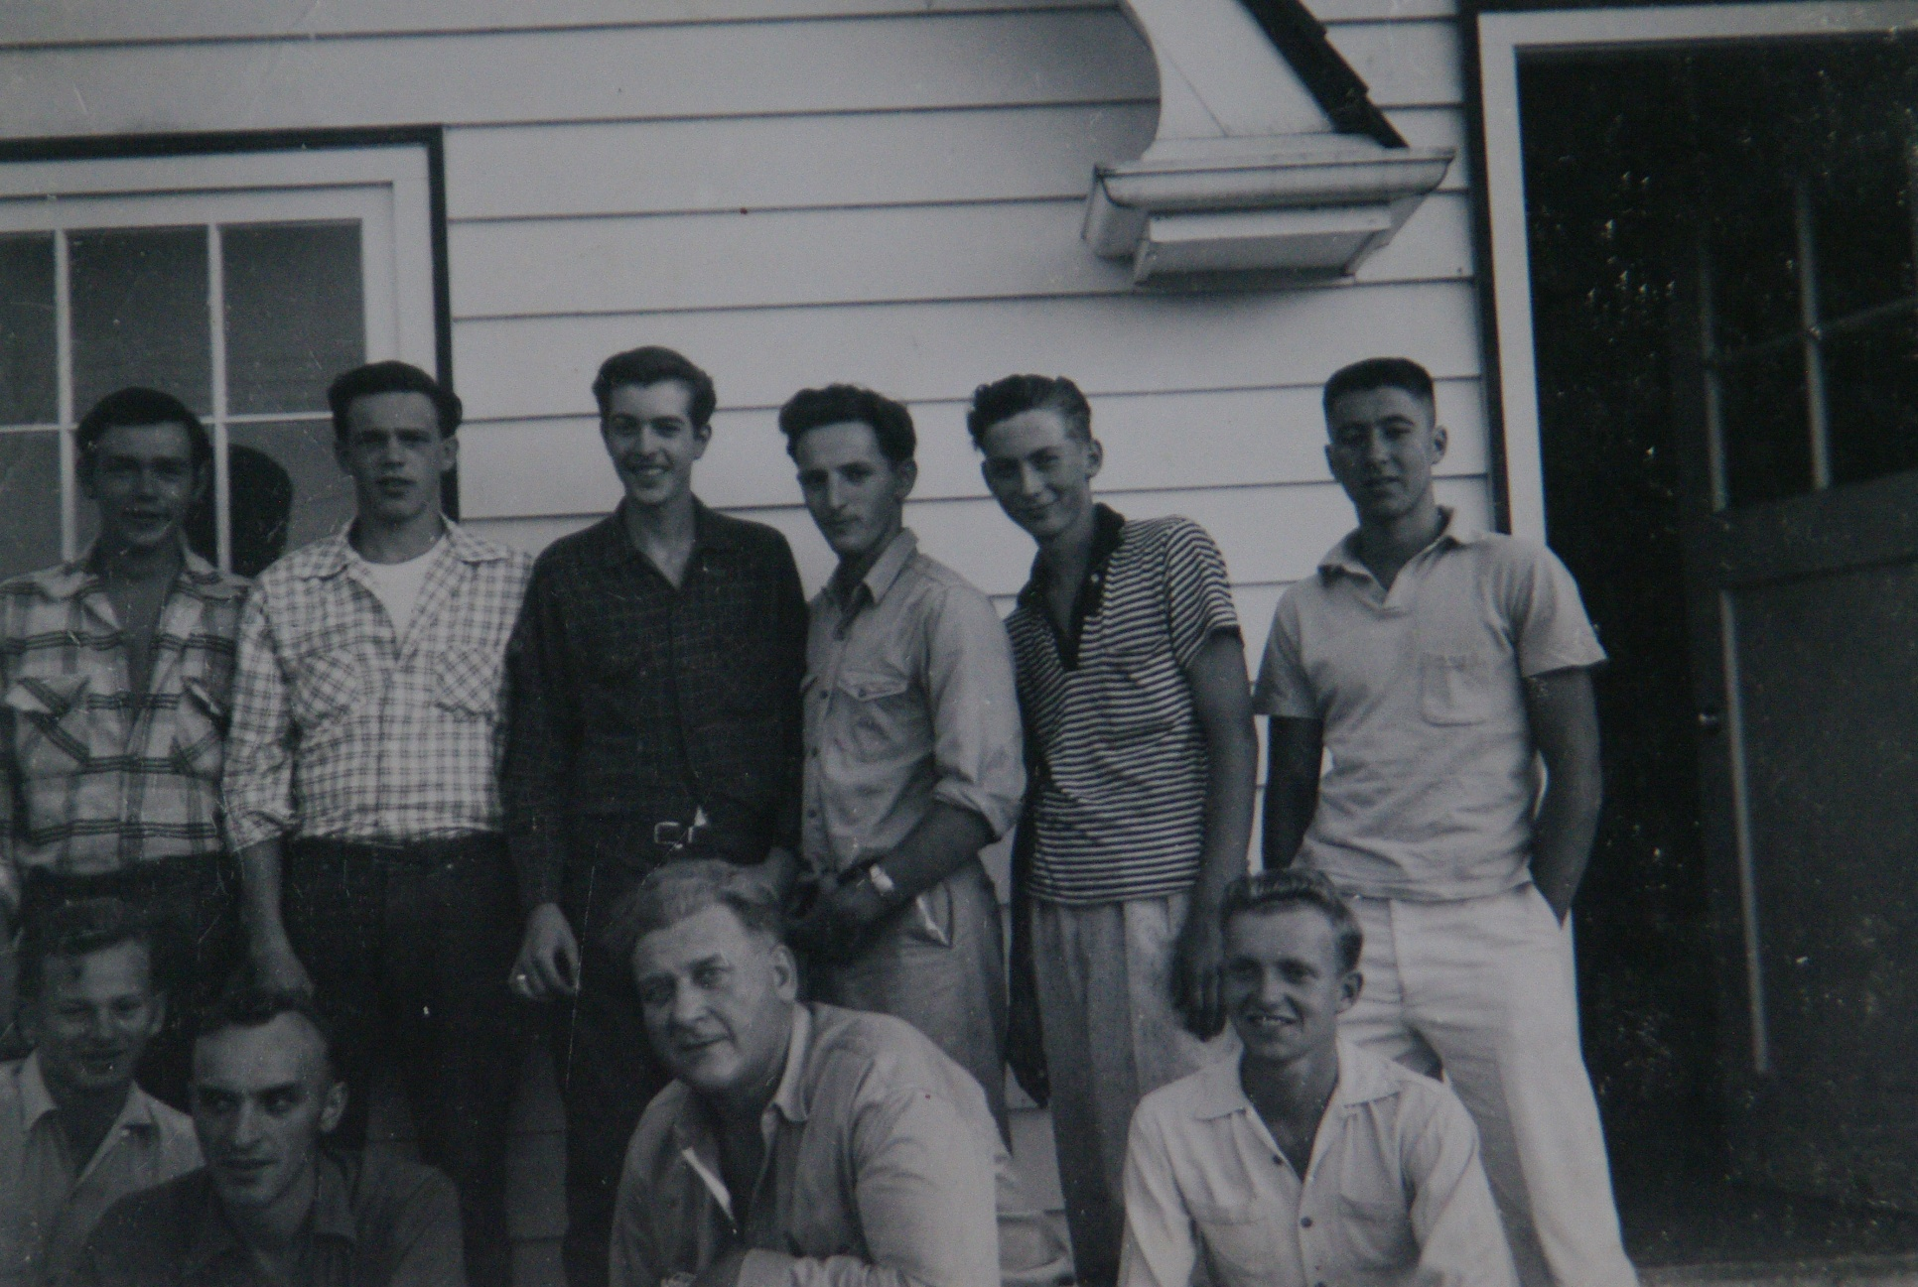
Coastal Fire Centre
Duncan Fire Suppression Crew circa 1950
courtesy Bruce Granholm

Slide 19
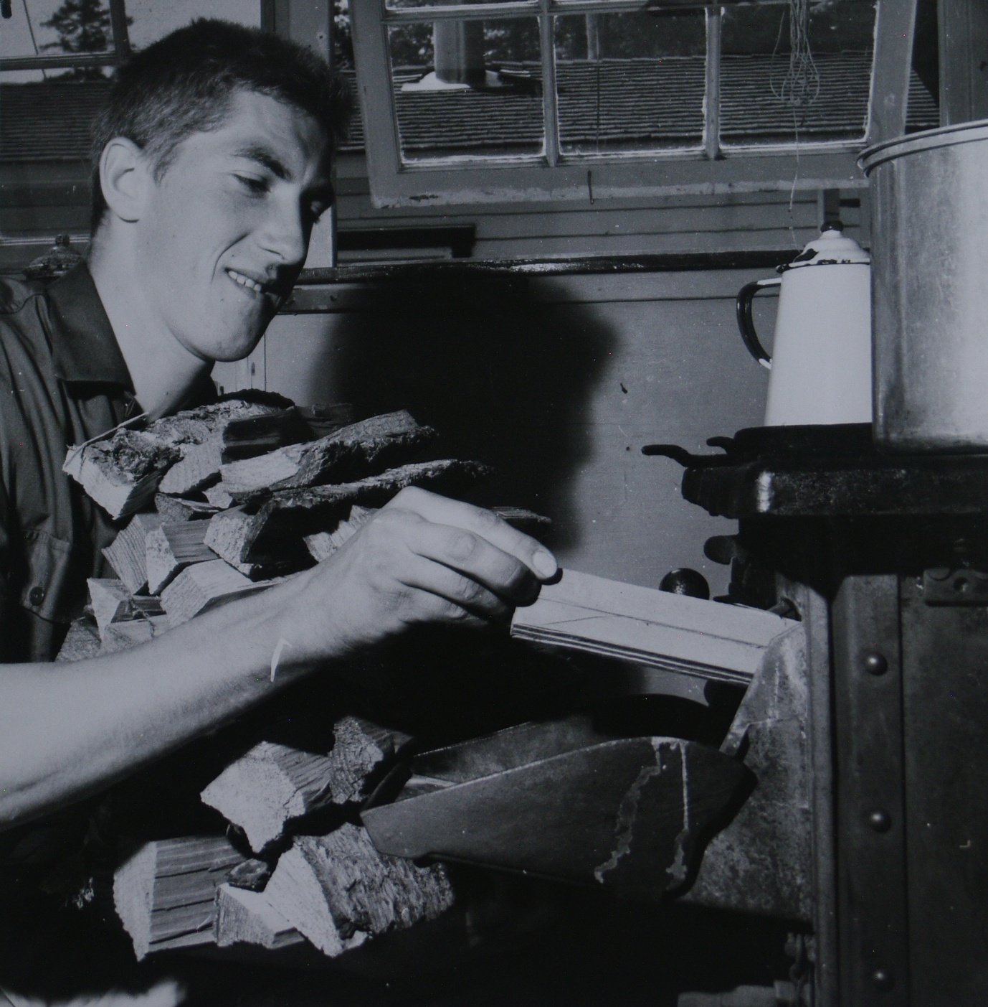
Lanford Fire Suppression Camp
1958
‘flunky’ feeding the cookhouse stove
courtesy Bruce Granholm

Slide 20
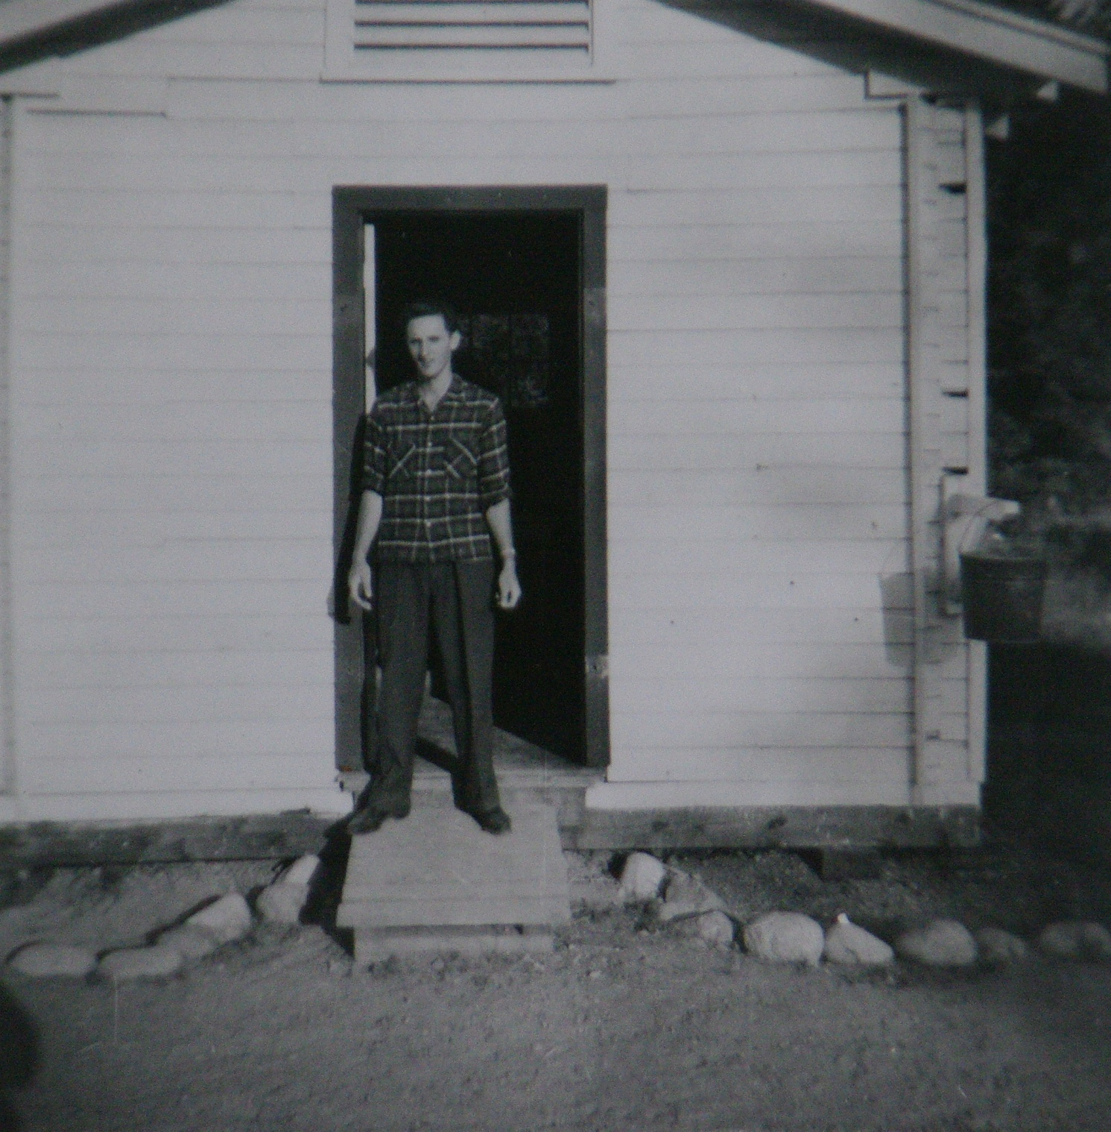
Coastal Fire Centre
Duncan Fire Suppression Camp
1958
Foreman Bruce Granholm outside his cabin/office
courtesy Bruce Granholm

Slide 21
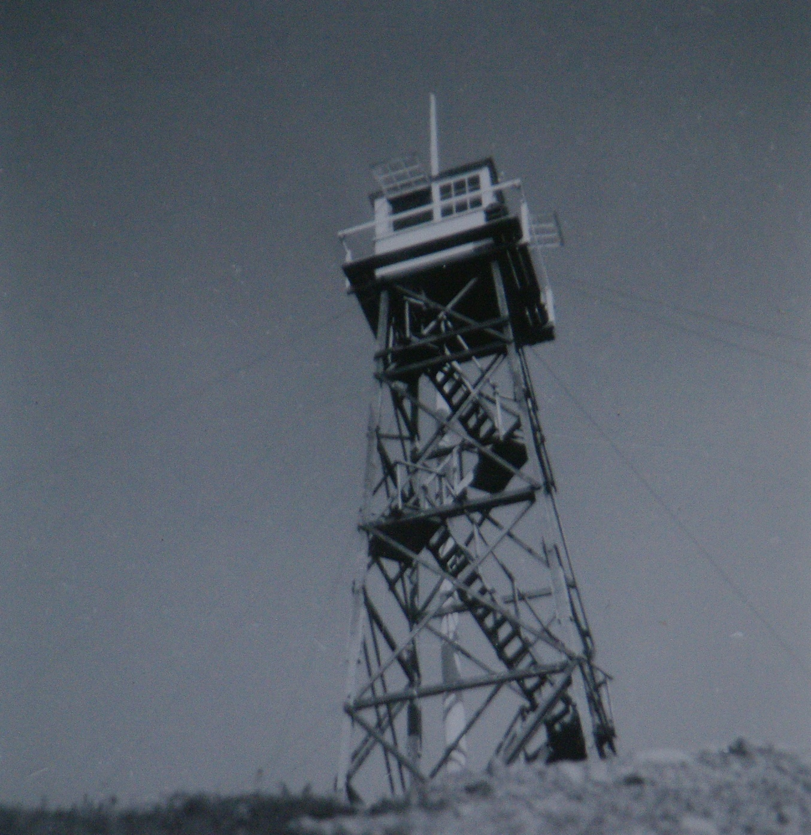
Coastal Fire Centre
Langford
Fire Lookout
Tower
at Mill Hill
1958
courtesy Bruce Granholm

Slide 22
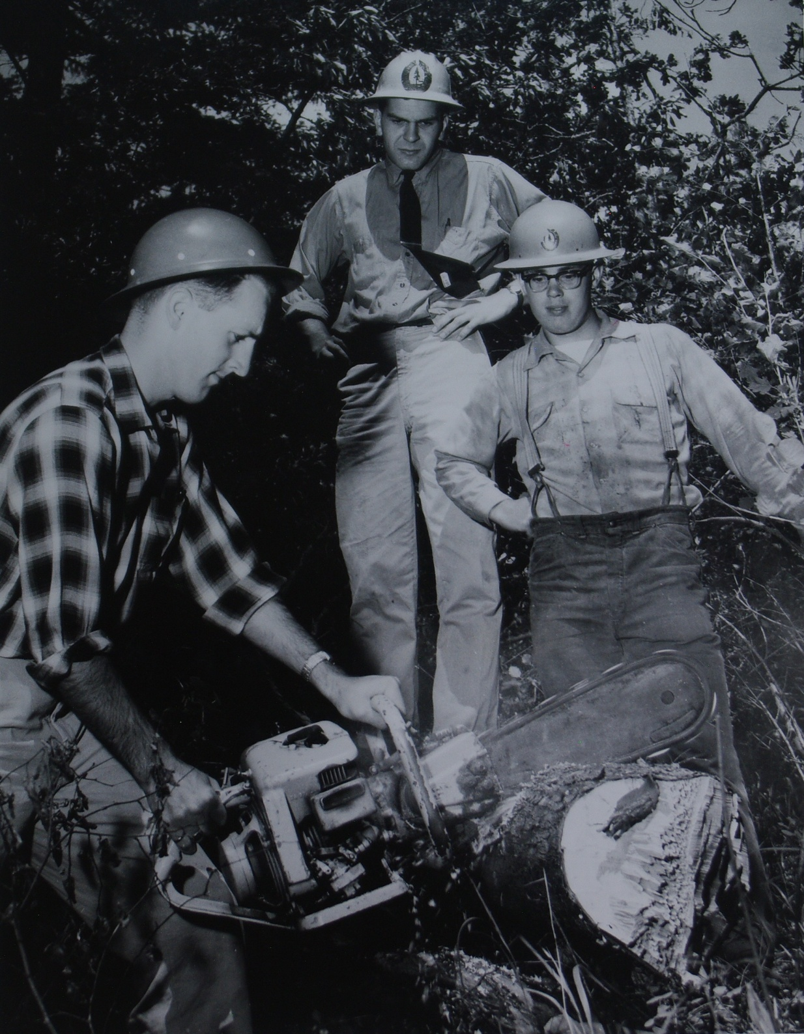
Langford Fire Suppression Camp 1958
Cutting wood
Left – Bruce Granholm
courtesy Bruce Granholm

Slide 23
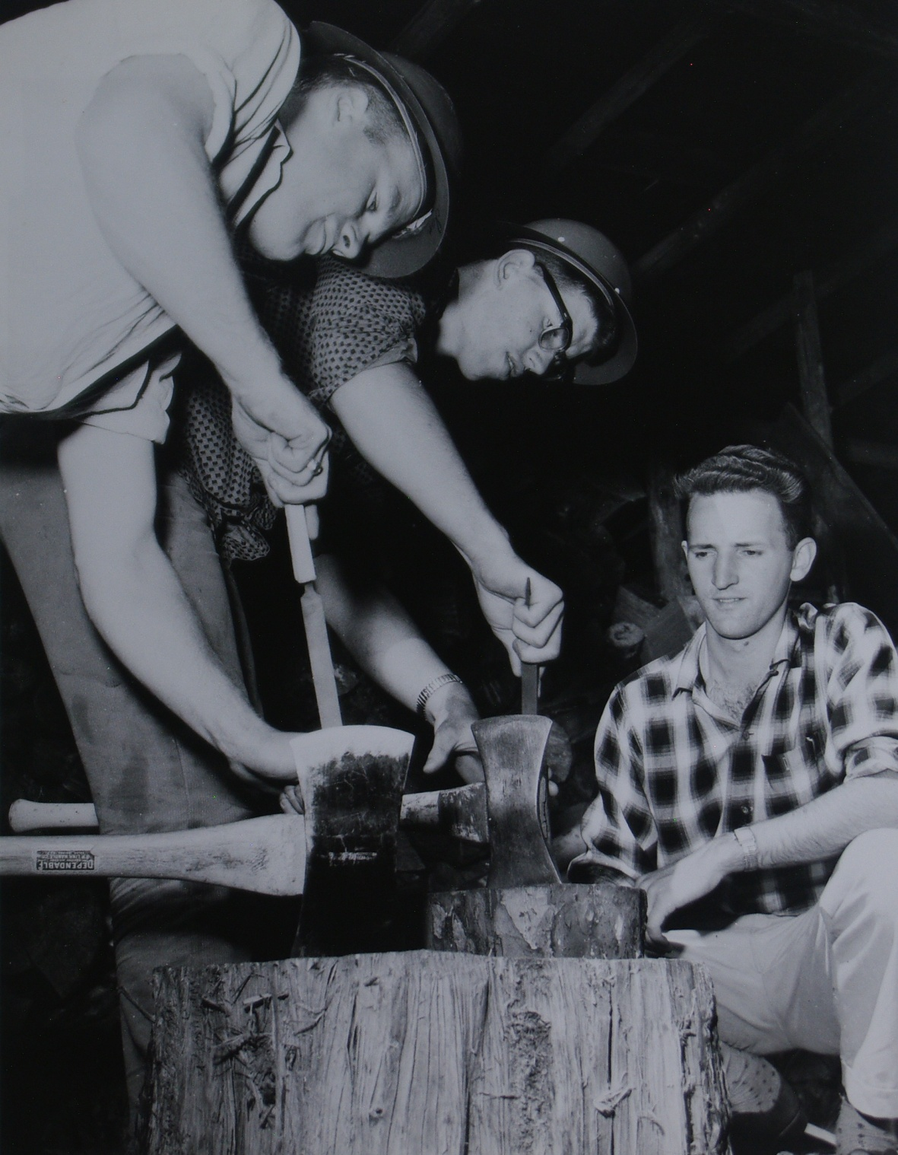
Langford Fire Suppression Camp 1958
Lesson in
sharpening axes
Left – Ian Frier
Right – Bruce Granholm
courtesy Bruce Granholm

Slide 24
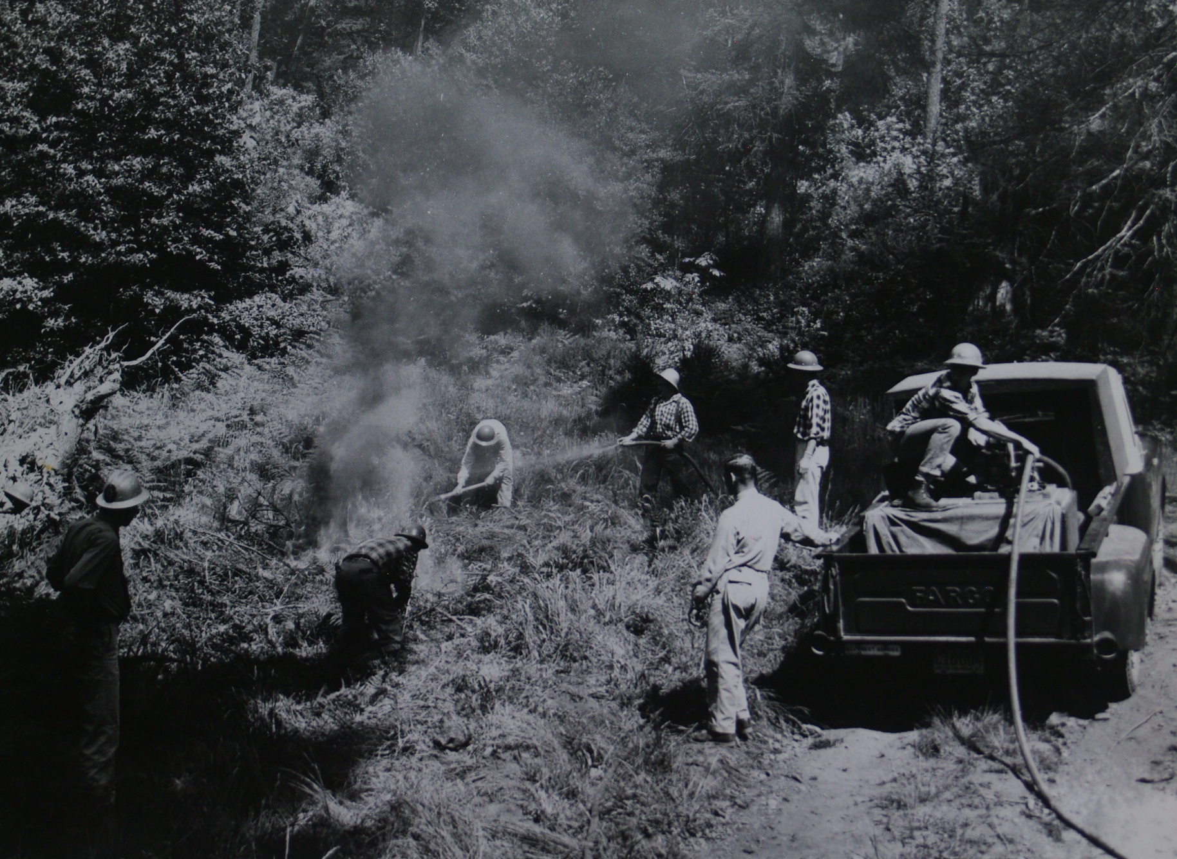
Coastal Fire Centre
Duncan Fire Suppression Crew 1958
Mock ‘fire drill’ for Victoria Colonist newspaper
courtesy Bruce Granholm

Slide 25
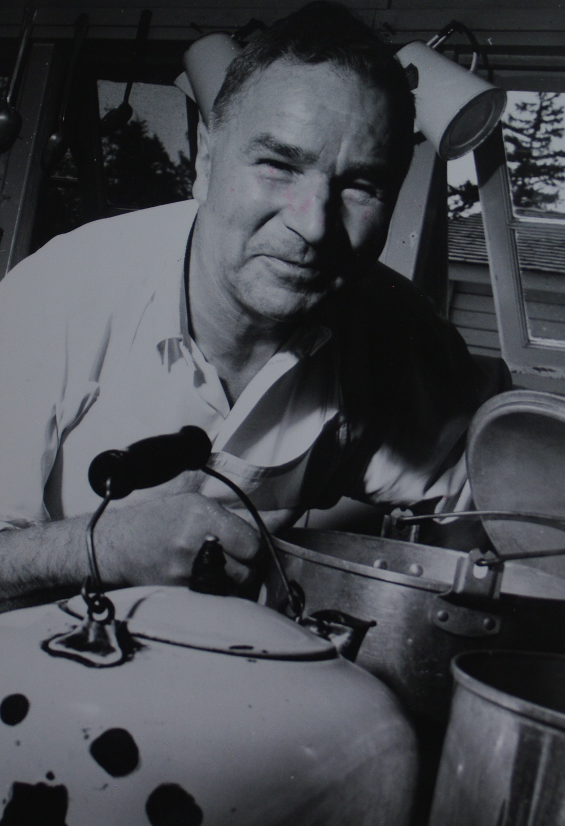
Langford Fire Suppression Camp
1958
Cook at work
courtesy Bruce Granholm

Slide 26
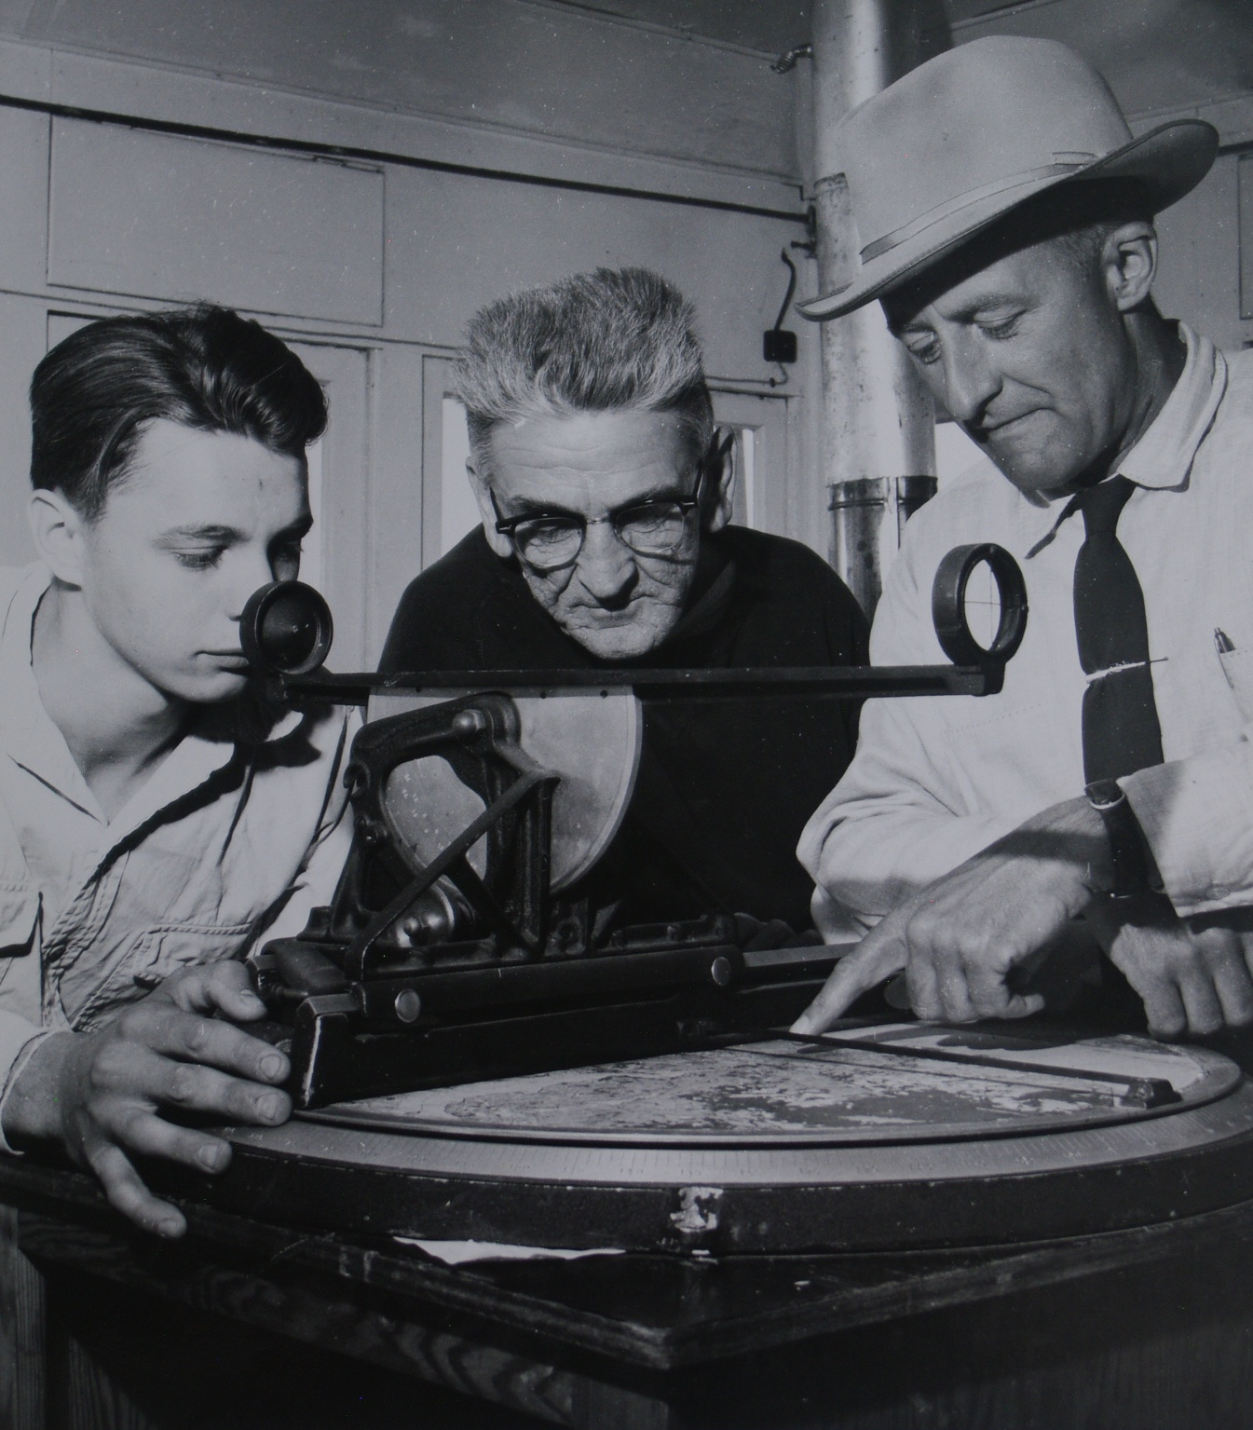
Langford
Fire lookout
1958
Ranger Ron Jones explaining Station Azimuth and elevation bearings
courtesy Bruce Granholm

Slide 27
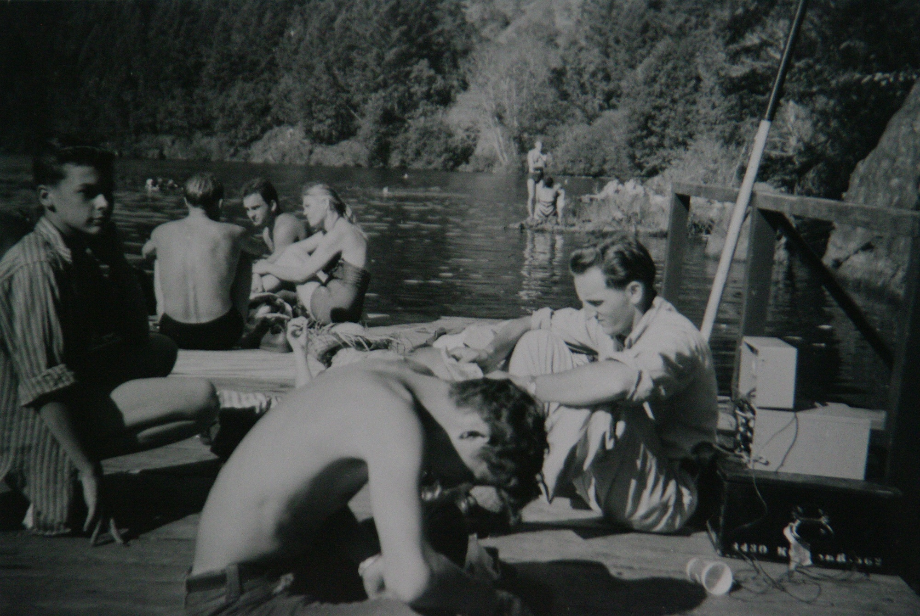
Coastal Fire Centre
Duncan Fire Suppression Crew at Thetis Lake -1957
Keeping in touch via AM radio
courtesy Bruce Granholm

Slide 28
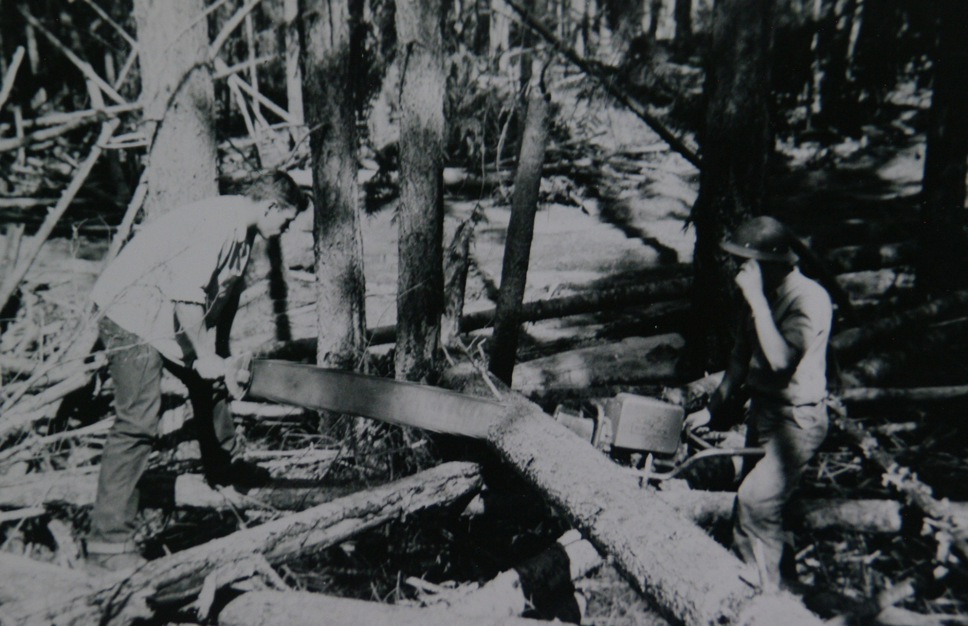
Coastal Fire Centre
Langford Fire Suppression Crew 1957
Cutting camp wood
courtesy Bruce Granholm

Slide 29
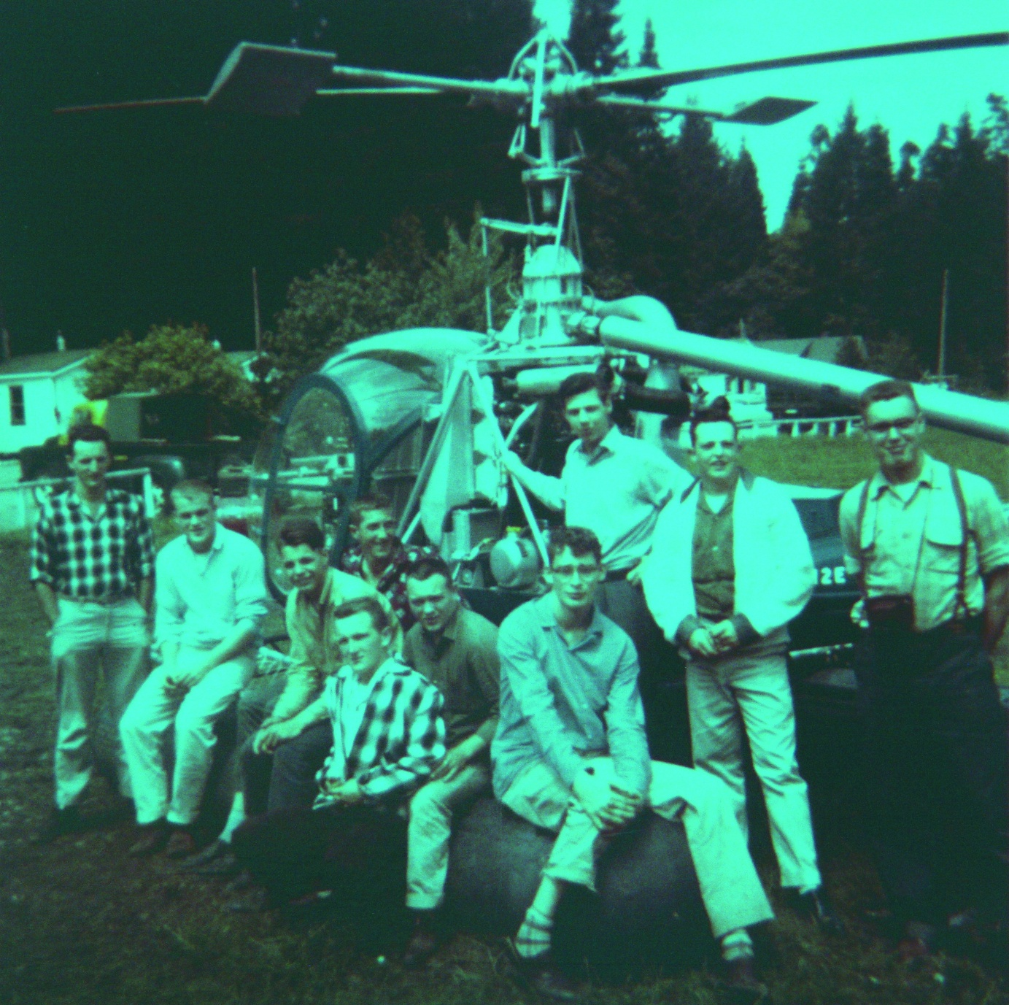
Coastal Fire Centre
Langford
Fire Suppression
Camp – 1958
Visiting BCFS Helicopter used for reconnaissance
Left: foreman Bruce Granholm
2nd from left – Ian Frier
Front 4th from left – Don Cairns
courtesy Bruce Granholm

Slide 30
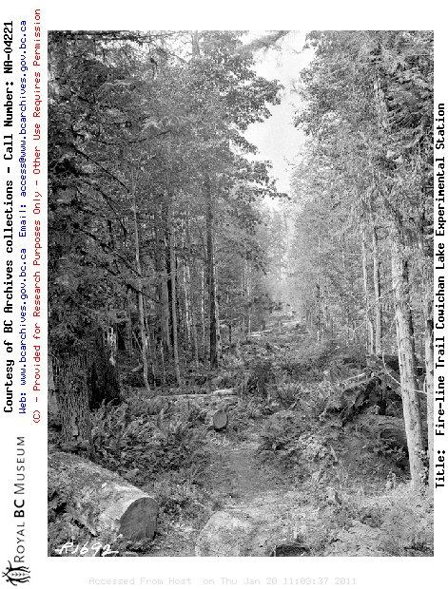
Fireline Trail
Cowichan Lake
Experimental
Station
courtesy
Royal BC Museum

Slide 31
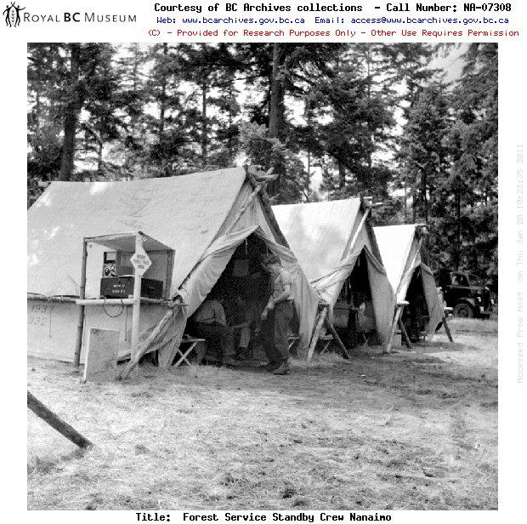
Forest Service Standby
Crew Nanaimo
courtesy
Royal BC Museum

Slide 32
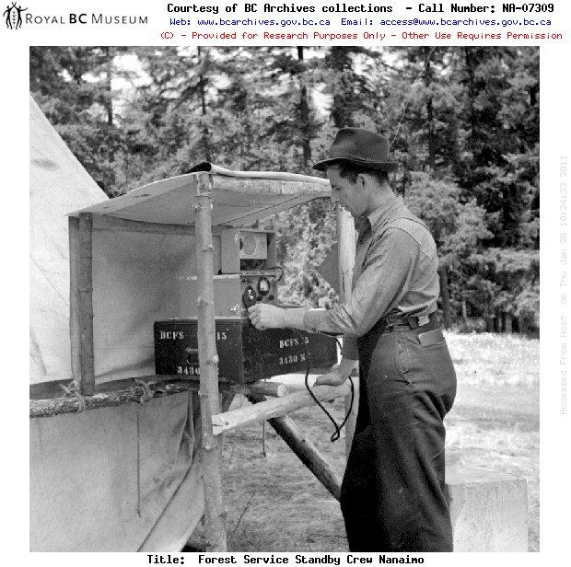
Coastal Fire Centre
Forest Service Standby
Crew Nanaimo
courtesy
Royal BC Museum

Slide 33
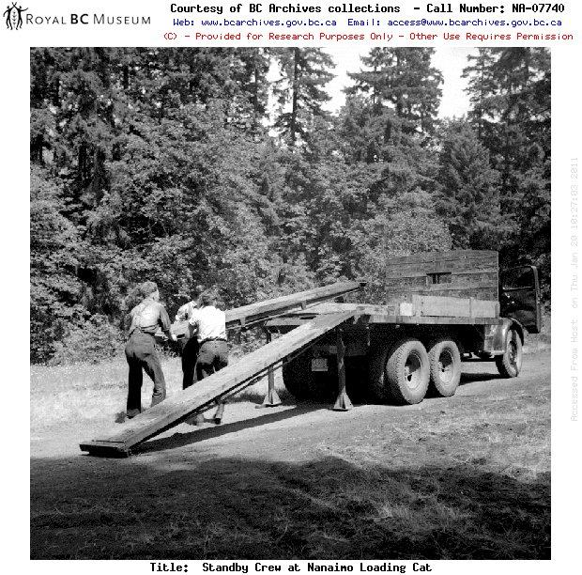
Coastal Fire Centre
Standby Crew
at
Nanaimo
Loading
Cat
courtesy
Royal BC Museum

Slide 34
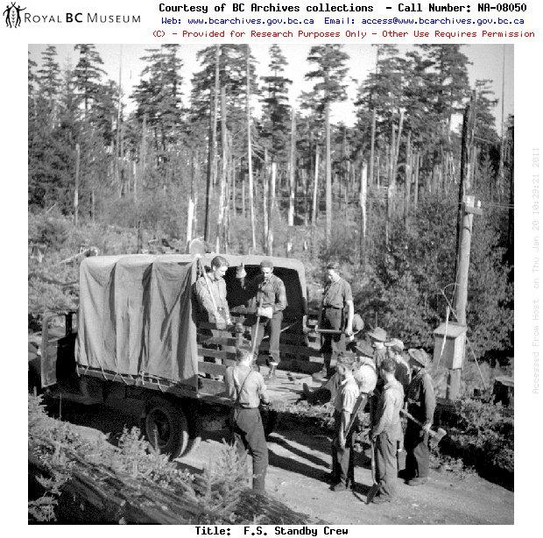
Forest Service Standby
Crew
courtesy
Royal BC Museum

Slide 35
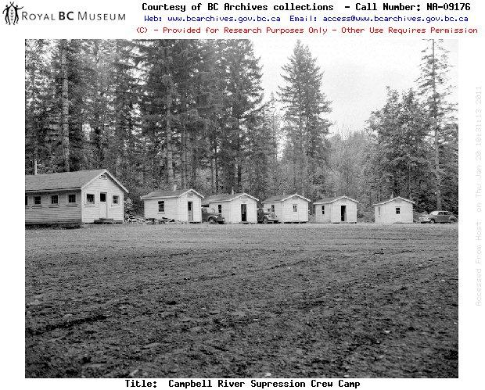
Campbell River Suppression Crew Camp
courtesy
Royal BC Museum

Slide 36
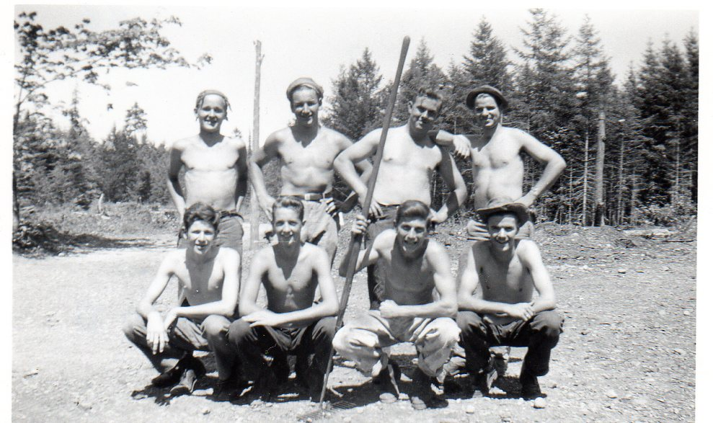
1948 Nanaimo Fire Suppression Crew
courtesy Norma Stromberg-Jones

Slide 37
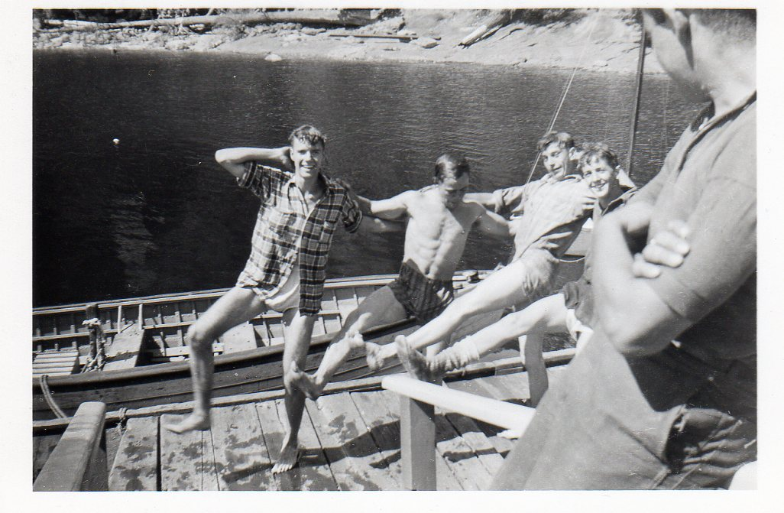
1948 Nanaimo Fire Suppression Crew
courtesy Norma Stromberg-Jones

Slide 38
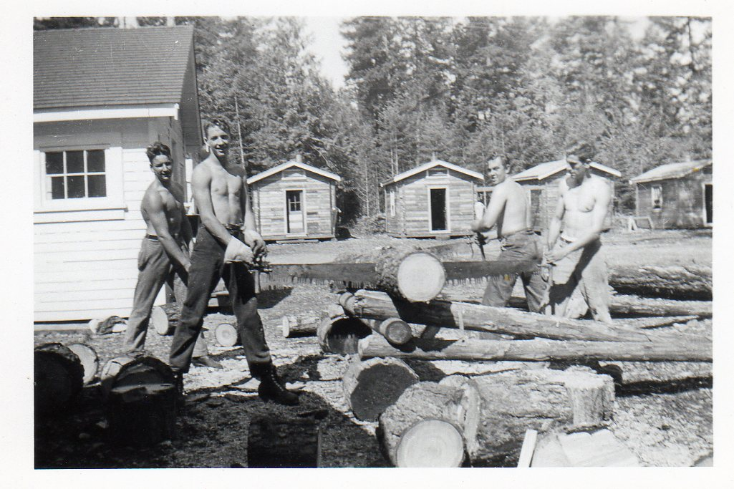
1948 Nanaimo Fire Suppression Crew
courtesy Norma Stromberg-Jones

Slide 39
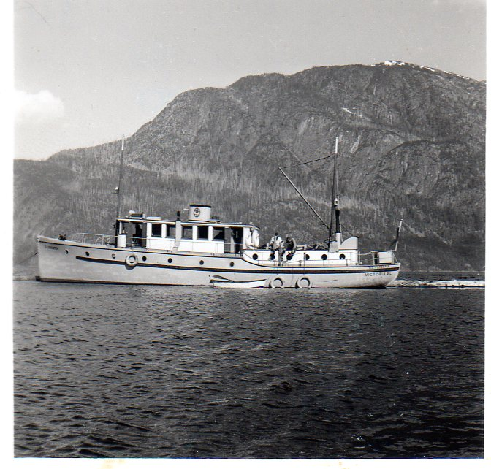
Coastal Fire Centre
1950
Boat Surveys & Inventory Crew:
BC Forester at sea
- Courtesy Norma Stromberg-Jones

Slide 40
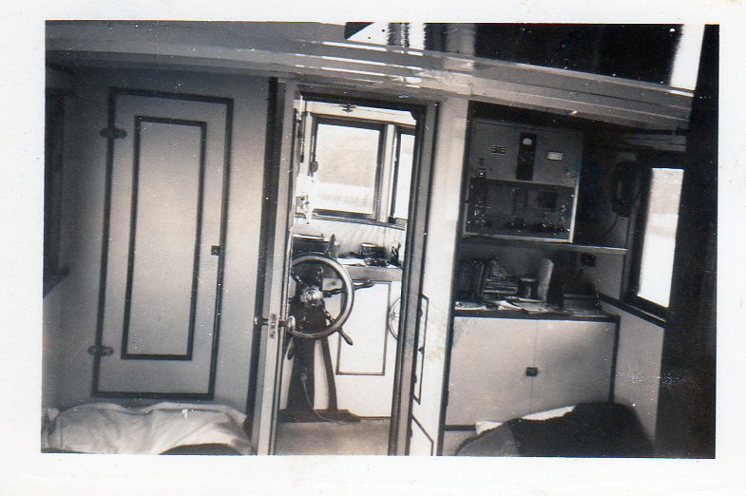
Coastal Fire Centre
- Courtesy Norma Stromberg-Jones
1950 Boat Surveys & Inventory Crew:
BC Forester interior and wheel house

Slide 41
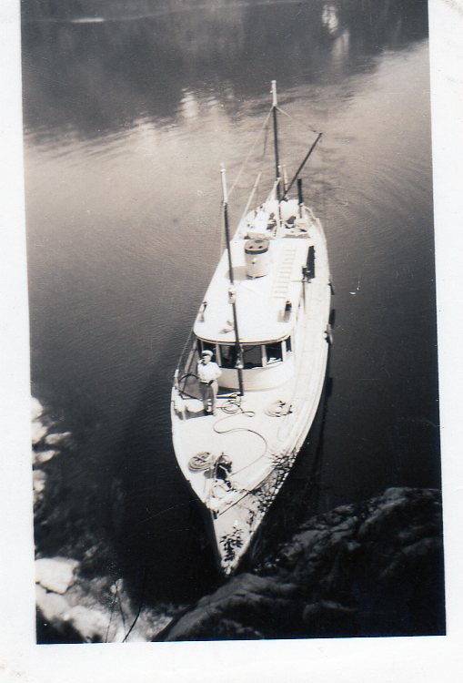
Coastal Fire Centre
1950
Boat Surveys & Inventory Crew:
BC Forester aerial view
- Courtesy Norma Stromberg-Jones

Slide 42
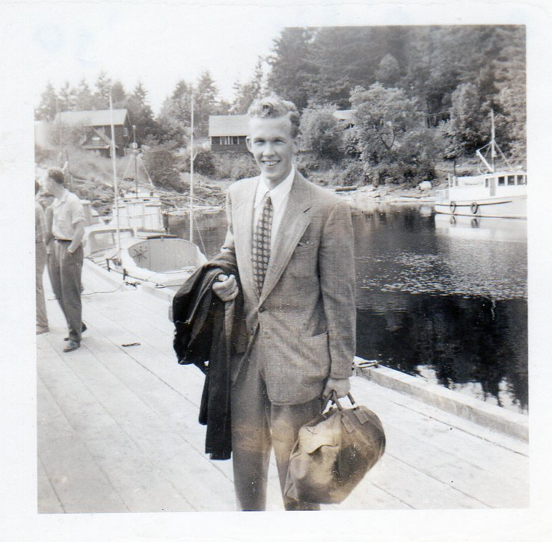
Coastal Fire Centre
1950
Boat Surveys & Inventory Crew:
Doug Richie
cook training for priesthood
- Courtesy Norma Stromberg-Jones

Slide 43
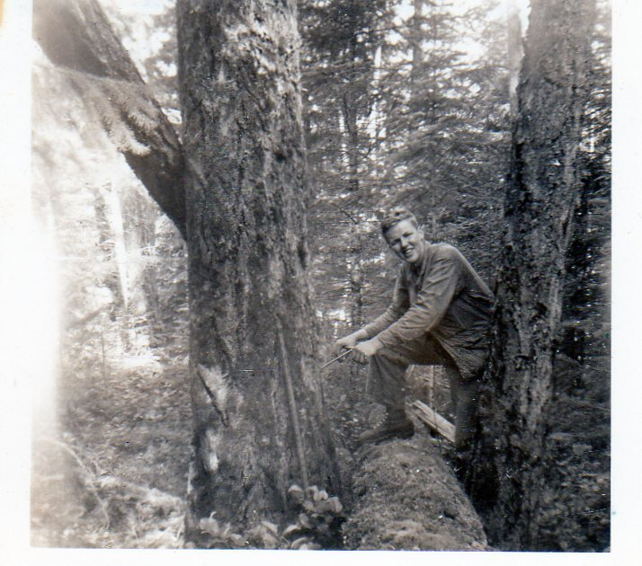
Coastal Fire Centre
1950
Boat Surveys & Inventory Crew:
Jim McWilliams
- Courtesy Norma Stromberg-Jones

Slide 44
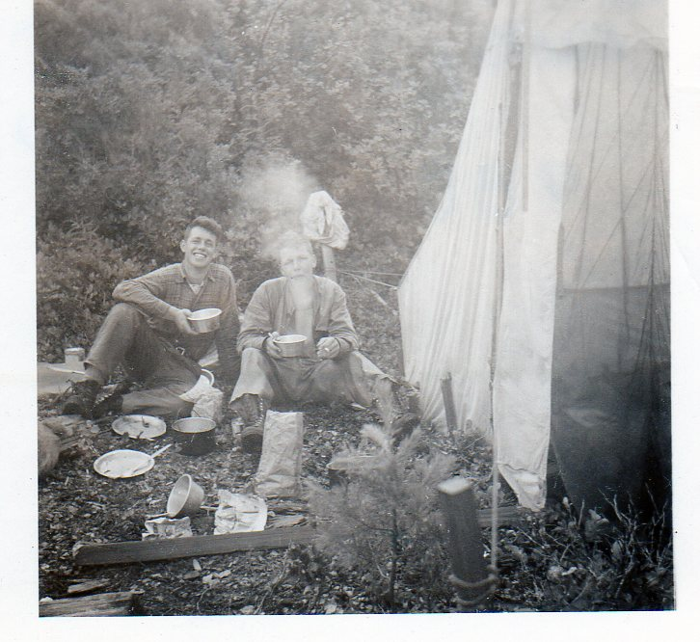
Coastal Fire Centre
1950
Boat Surveys & Inventory Crew:
Laddie MacKay
&
Jim McWilliams
- Courtesy Norma Stromberg-Jones

Slide 45
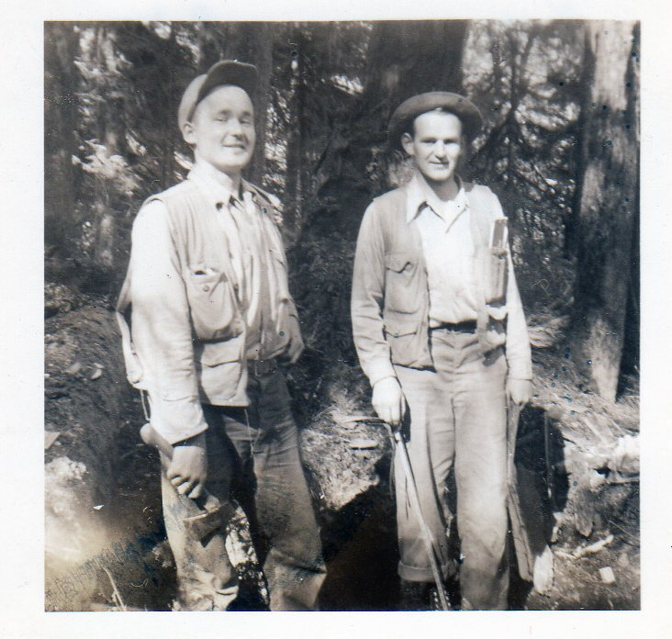
Coastal Fire Centre
1950
Boat Surveys & Inventory Crew:
Ron Stromberg
&
Bob
Wright
- Courtesy Norma Stromberg-Jones

Slide 46
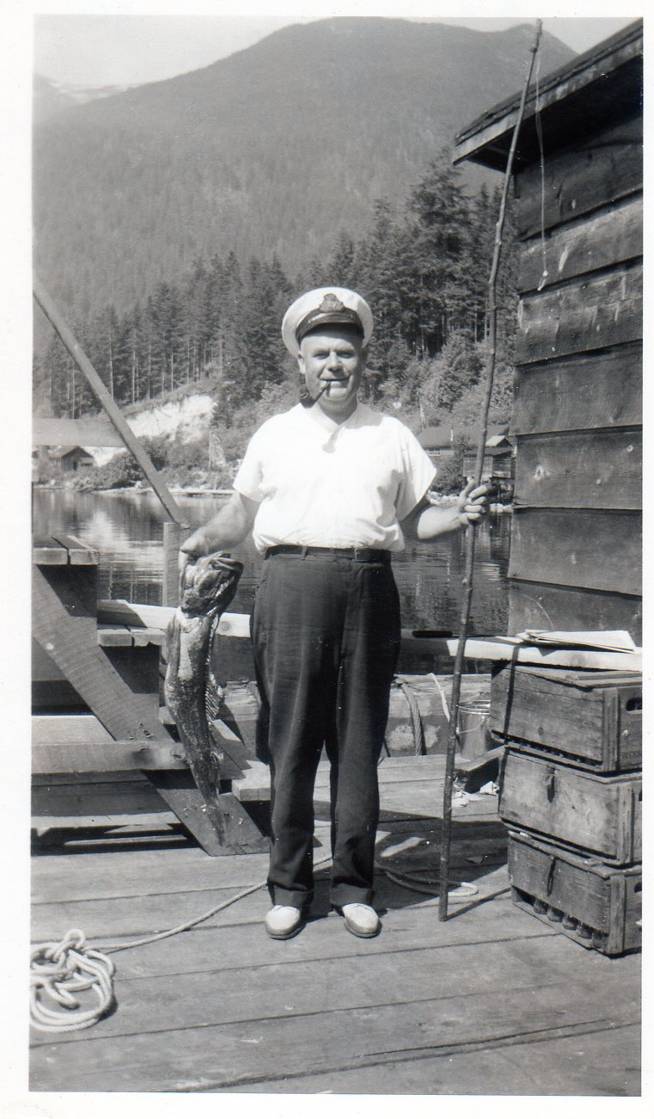
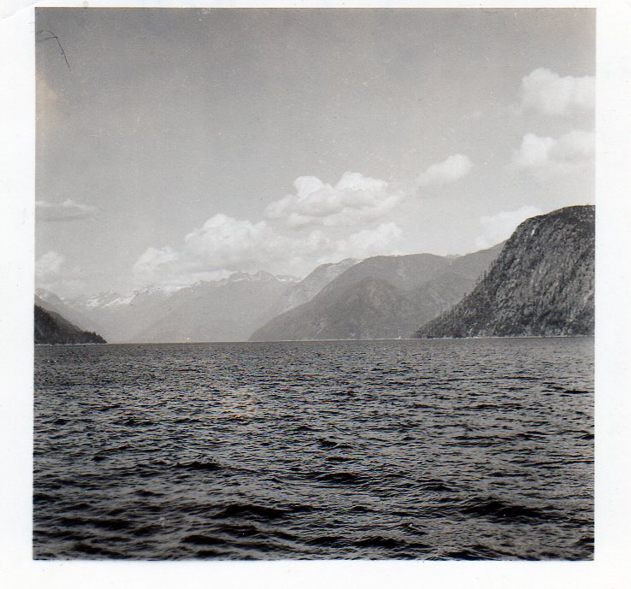
1950 Boat Surveys & Inventory Crew
- Courtesy Norma Stromberg-Jones
Jervis Inlet
Captain Jack McLeod
BC Forester

Slide 47
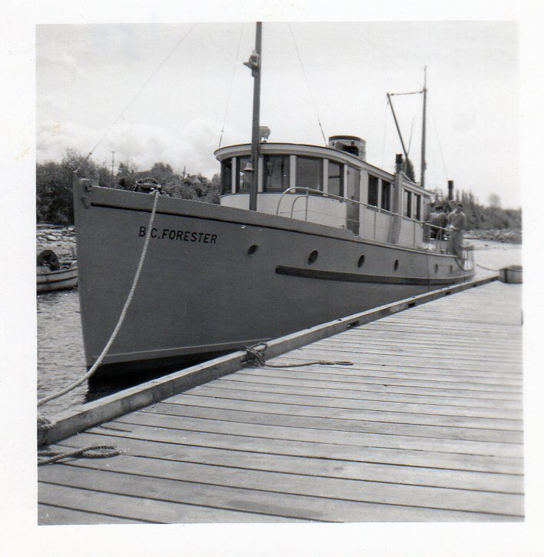
Coastal Fire Centre
1950
Boat Surveys & Inventory Crew:
BC Forester at dock
- Courtesy Norma Stromberg-Jones

Slide 48
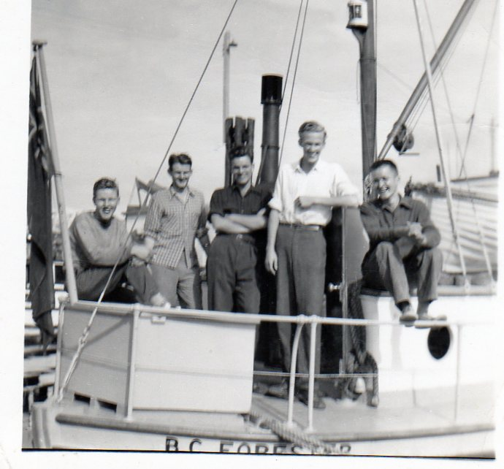
Coastal Fire Centre
1950
Boat Surveys & Inventory Crew:
Survey
Inventory
crew
- Courtesy Norma Stromberg-Jones

Slide 49
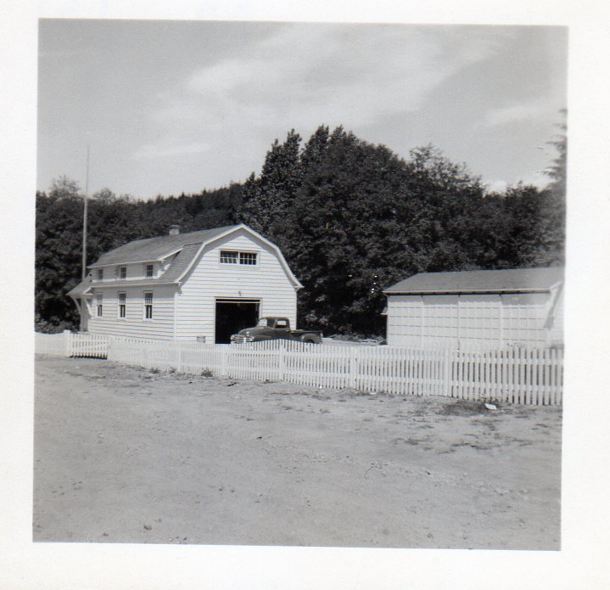
Coastal Fire Centre
1951
Powell River
Ass’t Ranger
Ronald Stromberg series:
Powell River Ranger Station
- Courtesy Norma Stromberg-Jones

Slide 50

Coastal Fire Centre
1951
Powell River
Ass’t Ranger
Ronald Stromberg series:
Ranger Bill Black &
radio operator
- Courtesy Norma Stromberg-Jones

Slide 51

Coastal Fire Centre
1951
Powell River
Ass’t Ranger
Ronald Stromberg series:
Bob Smith
- Courtesy Norma Stromberg-Jones

Slide 52

Coastal Fire Centre
1951
Powell River
Ass’t Ranger
Ronald Stromberg series:
Assistant Ranger Ronald Stromberg
- Courtesy Norma Stromberg-Jones

Slide 53

Coastal Fire Centre
1951
Powell River
Ass’t Ranger
Ronald Stromberg series:
Ron Stromberg
& co-workers
- Courtesy Norma Stromberg-Jones

Slide 54

1951
Powell River
Ass’t Ranger
Ronald Stromberg series:
Tin Hat Lookout
- Courtesy Norma Stromberg-Jones

Slide 55

Coastal Fire Centre
1951
Powell River
Ass’t Ranger
Ronald Stromberg series:
Tin Hat Lookout
- Courtesy Norma Stromberg-Jones

Slide 56

1951 Powell River
Ass’t Ranger
Ronald Stromberg series:
Truck with
Bob Rourke and
Ron Stromberg
- Courtesy Norma Stromberg-Jones

Slide 57

Coastal Fire Centre
1951 Powell River
Ass’t Ranger
Ronald Stromberg series:
Fire Powell River district 1951
- Courtesy Norma Stromberg-Jones

Slide 58

Coastal Fire Centre
1951 Powell River
Ass’t Ranger
Ronald Stromberg series:
Assistant Ranger Ron Stromberg
- Courtesy Norma Stromberg-Jones

Slide 59

Coastal Fire Centre
1951 Powell River
Ass’t Ranger
Ronald Stromberg series:
Bob Rourke
- Courtesy Norma Stromberg-Jones

Slide 60

Coastal Fire Centre
1951 Powell River
Ass’t Ranger
Ronald Stromberg series:
Powell River Townsite 1951
- Courtesy Norma Stromberg-Jones

